Slide 1
Robotic Mining
Friday September 29th, 2017

Slide 2
What is Robotic Mining?
Recent discoveries by NASA missions to Mars have found large amounts of water in the form of water ice at the higher latitudes and also hydrated minerals globally on Mars
Capturing this water is the key to allow humans to “live off the land”
The minerals and soil are typically in the form of crushed and weathered rock called “regolith”, which must be removed to get to the water ice below.

Slide 3
What is Robotic Mining?
This competition is for university-level students to design and build a mining robot that can traverse the challenging simulated chaotic off-world terrain
The mining robot must then excavate the ice simulant (gravel) and return the excavated mass for deposit into the collector bin to simulate an off-world mining mission

Slide 4
Complexities
The abrasive characteristics of the regolith simulant
The weight and size limitations of the mining robot
The ability to tele-operate it from a remote Mission Control Center
Dust tolerance and dust projection
Communications
Vehicle mass
Energy/power requirements
Autonomy

Slide 5
The Robotic Mining Competition Three Lines of Business Focus
Technology -Technology Drives Exploration. We develop, test and fly transformative capabilities and cutting edge exploration technologies. Our technology development provides the onramp for new ideas, maturing them from early stage through flight and giving wings to the innovation economy.
Mars -We are on a journey to Mars. Today our robotic scientific explorers are blazing the trail. Together, humans and robotics will pioneer the next giant leap in exploration.
Solar System and Beyond NASA -We're Out There. NASA's exploration spans the universe. Observing the sun and its effects on Earth. Delving deep into our solar system. Looking beyond to worlds around other stars. Probing the mysterious structures and origins of our universe. Everywhere imaginable, NASA is out there.

Slide 6
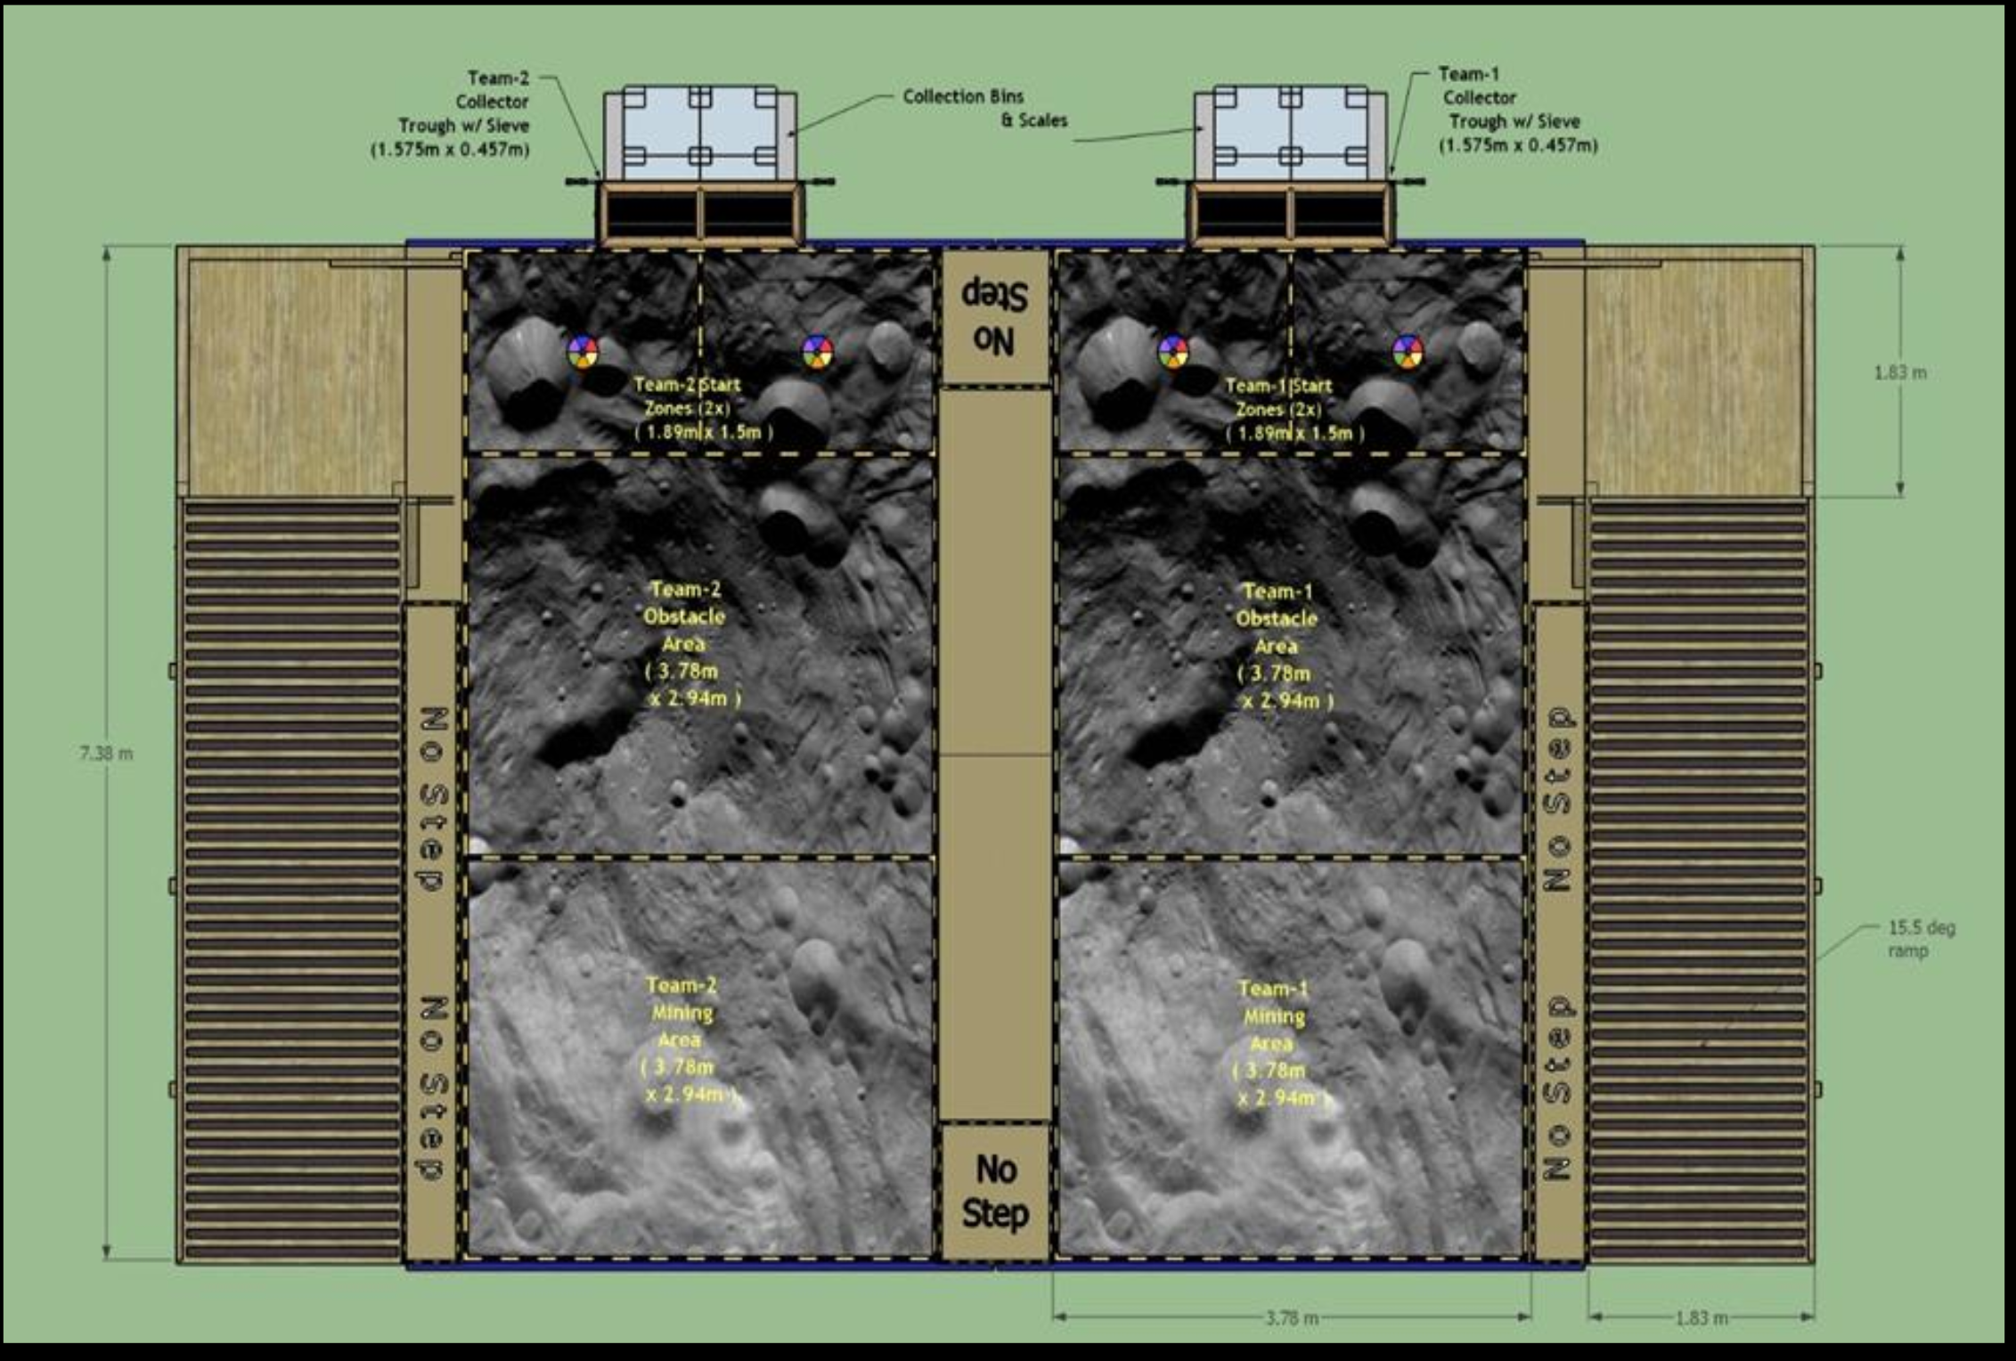
Arena

Slide 7
Arena
The top layer is around 30 cm deep of BP-1 regolith simulant
In the mining area there is 30 cm of gravel (icy regolith simulant) under the BP-1
The goal is to collect as much gravel as possible within 10 minutes

Slide 8
Requirements
At least 1 kg of gravel must be mined
  If the minimum amount of gravel is not mined, then the total score for that attempt is 0
  For each additional kilogram of gravel mined, the team earns 15 points
The maximum mass of the robot is 80 kg
  Also for each kilogram of mass, the team loses 8 points
The starting dimensions of the robot are 1.5 m X 0.75 m X 0.75 m
  The robot may expand but the height must not exceed 1.5 m

Slide 9
Requirements
The team will lose 1 point for each 50 kb/s of average data used
  Each team will lose 200 kb/s of data for each situational awareness camera used
The team will lose 1 point for each w-h of energy consumed
The mining robot cannot employ any fundamental physical processes, gases, fluids or consumables that would not work in a Martian environment
The team can earn points for dust-tolerant design, dust-free operation, and autonomous operation
The team earns 1000 points for passing the safety inspection

Slide 10
Competition
Unfortunately the registration for the competition is limited to the first 50 teams
We were unable to register this year, but that means next year we could be very competitive
Realistically if we get a working, autonomous robot this year I will consider our project a success

Slide 11
System Engineering
There is a heavy emphasis on SE
Throughout the year we will be working on a SE paper
This will be good practice for next year, and will give next year’s team a starting point

Slide 12
Tasks for Today
Research previous team’s designs / SE papers
Research avenues for building a robot
Research the properties of BP-1

