Slide 1
Middle River Aerostructure Systems (MRAS)
18 November 2022

Slide 2
Presentation Includes: Technical info of commercial nacelle hardware
Technical Data (select all that apply):
License Required (Lic. No. __________ )
No License Required (ECCN: 9E991 )
No Technical Information
Proprietary Information: (select all that apply):
MRA Systems, LLC Proprietary – Internal Use Only
MRA Systems, LLC Proprietary – Acceptable for External Use
Non-Proprietary
Audience Includes:
MRA Systems, LLC Only
Non-MRA Systems, LLC
Non-US
X
X
X
X
The information contained in this document is MRA Systems, LLC (MRAS) proprietary information and is disclosed in confidence. It is the property of MRAS and shall not be used, disclosed to others or reproduced without the express written consent of MRAS, including, but without limitation, it is not to be used in the creation, manufacture, development, or derivation of any repairs, modifications, spare parts, designs, or configuration changes or to obtain FAA or any other government or regulatory approval to do so. If consent is given for reproduction in whole or in part, this notice and the notice set forth on each page of this document shall appear in any such reproduction in whole or in part. This technical data is considered ITAR and/or EAR controlled pursuant to 22 CFR Part 120-130 and 15 CFR Parts 730-774 respectively. Transfer of this data by any means to a Non-US Person, whether in the United States or abroad, without the proper U.S. Government authorization (e.g., License, exemption, NLR, etc.), is strictly prohibited.

Slide 3
Outline
Who am I?
What is MRAS?
Technical stuff:
  How do turbofan engines work?
  Whats a Nacelle?
Career stuff:
  My career path
  What do I do?
  Career advice
  We’re hiring!

Slide 4
Who am I?

Slide 5


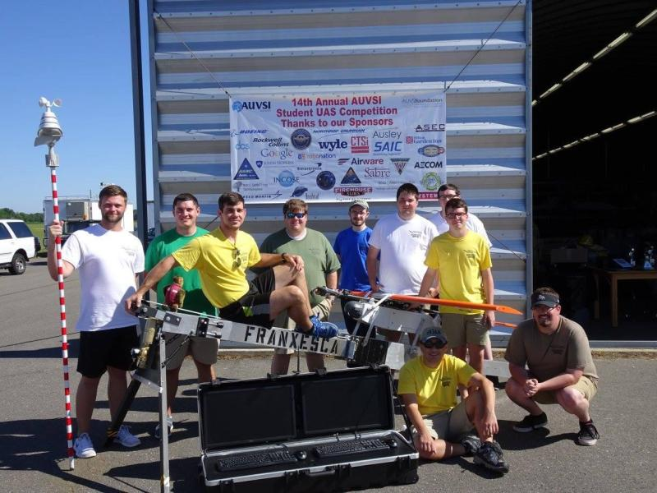
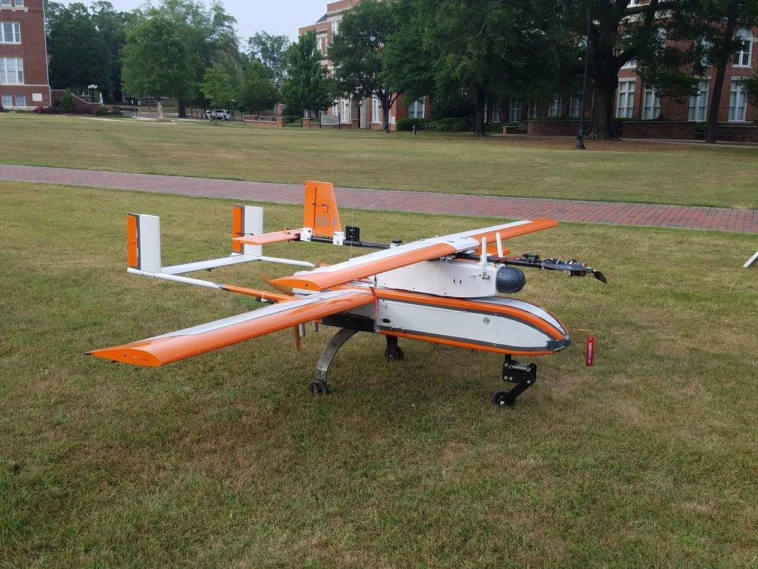
Charles Spinnato
Lead Design Engineer
B.S. Aerospace Engineering (Aeronautics concentration), Mississippi State University
Academic experience:
  AUVSI student UAS competition
    Design, Build, Operate a UAV to perform ISR/Air delivery mission.
    Multidisciplinary team included many different majors (aero, mech, electrical, CS, software)
  Senior Thesis
    Design and evaluate different wingtip devices for use on small-to-medium UAVs

Slide 6
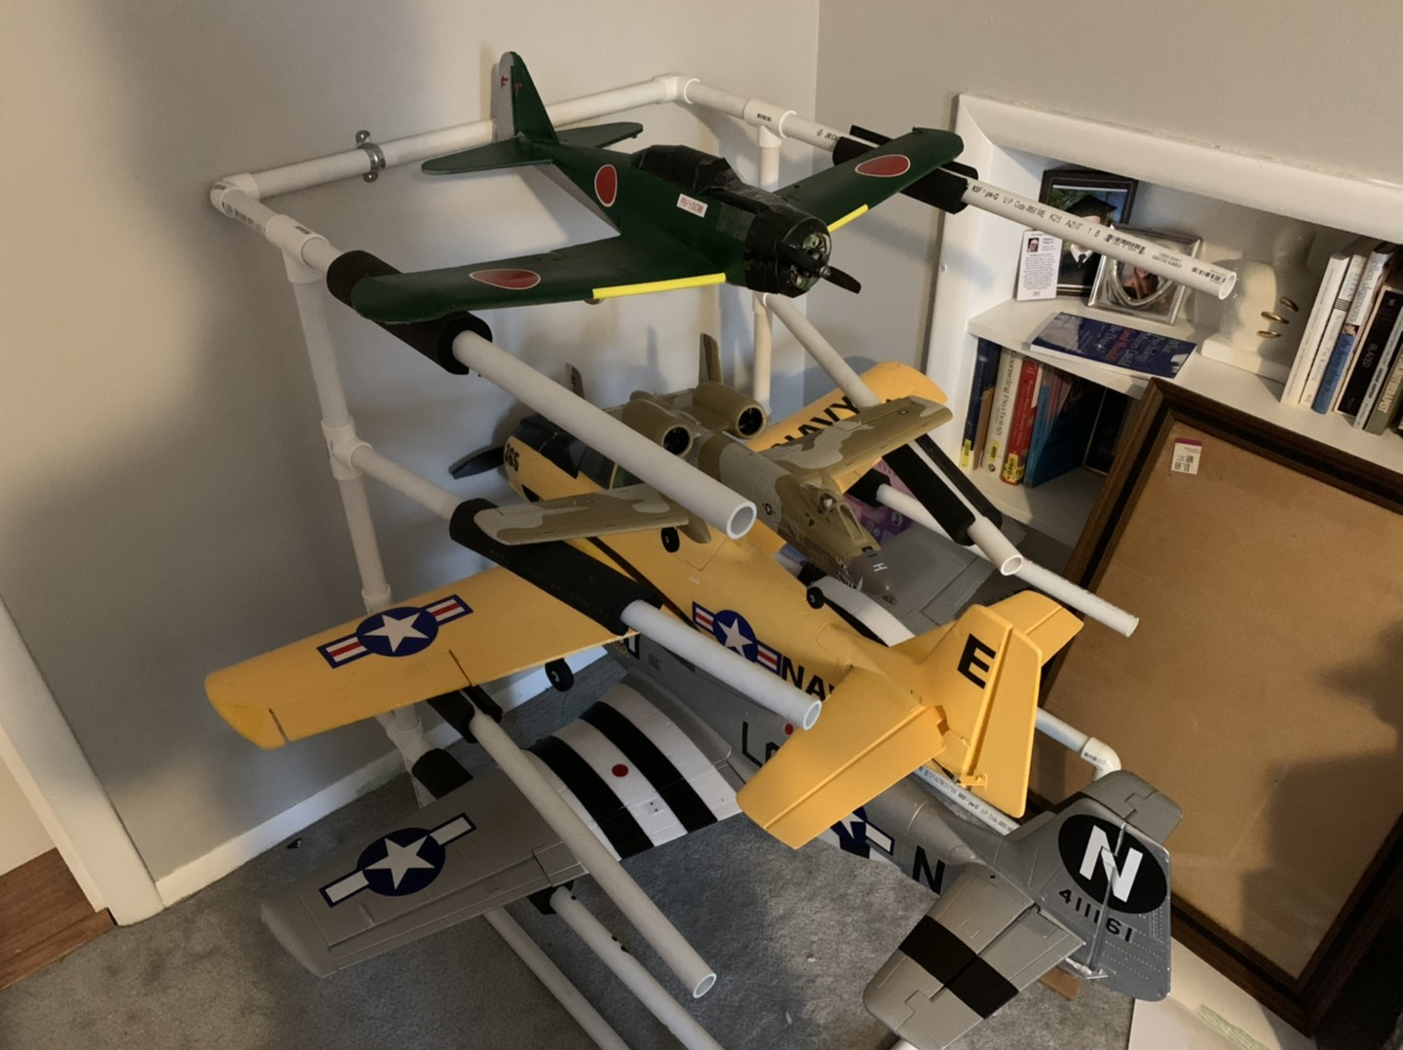
More About Me
Born in White Marsh, MD
Married 4/2021
  Expecting 1st child March 2023!
Big Orioles / Ravens / Mississippi State sports fan
Hobbies:
  Avid RC aircraft pilot
  Music (Drums, Guitar)
  Video games (pretty much every genre)

Slide 7
What is MRAS?

Slide 8
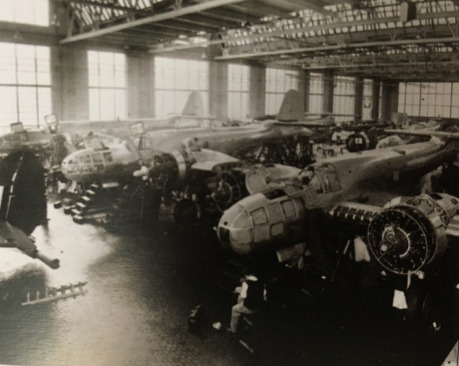
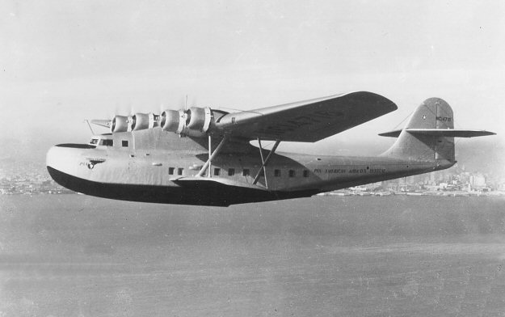
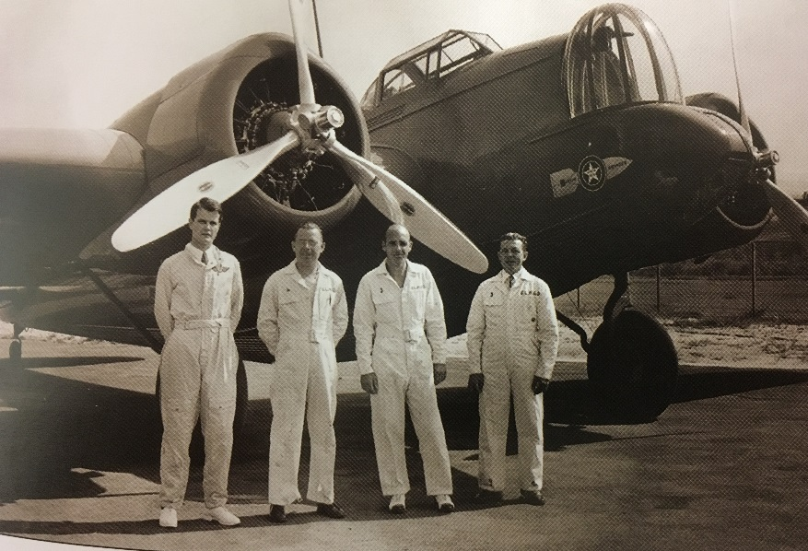
MRAS History
Glenn L. Martin: Early aviation enthusiast and pioneer
Early Business dealings
  1915: Trained William Boeing how to fly and sold him 1st aircraft
  1915: Hired Donald Douglas from MIT
  1916: Briefly merged with Wright Brothers company
Originally manufactured planes at a Cleveland, OH plant but moved company operations to Middle River, MD in 1928
Produced multiple bomber planes for US & foreign customers, including the B-10
Produced the Martin M-130 for Pan Am - “China Clipper”
  First commercial transpacific flights from California to the Philippines
M-130
B-10B

Slide 9
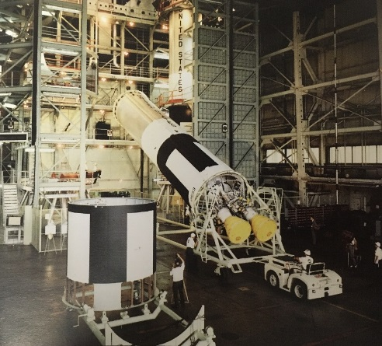
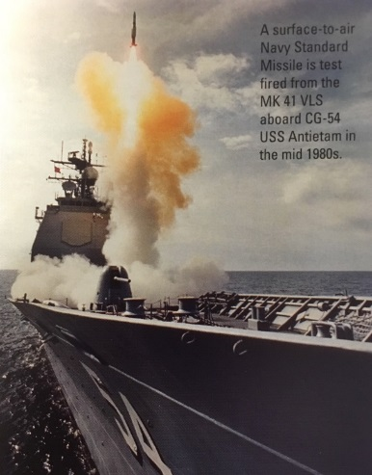
MRAS History
WWII: Produced the B-26 Marauder bomber & expanded manufacturing capability with government support
Post War: Produced commercial airplane Martin 4-0-4, the B-57 bomber, P5M Marlin seaplane & P6M Sea Master jet
1961: The Martin company was bought by American Marietta to become Martin Marietta
1970’s: Transitioned into the missile & space industry with the Titan program
1980’s: Vertical launch systems, Patriot Launcher PAC-3 system, MK 41 VLS for the Navy
1995: Merger between Martin Marietta & Lockheed created one of the largest defense contractor in the world: Lockheed Martin
1997: The Middle River Aircraft Systems nacelle business was created as a wholly owned subsidiary within the GE family
2019: MRAS is sold to ST Engineering

Slide 10
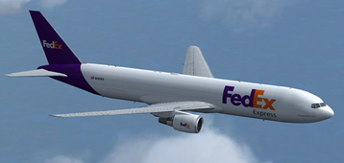
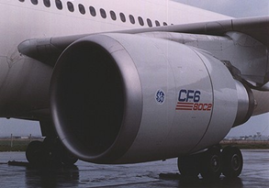
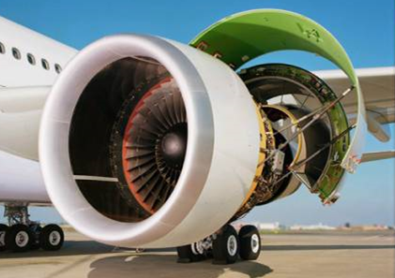
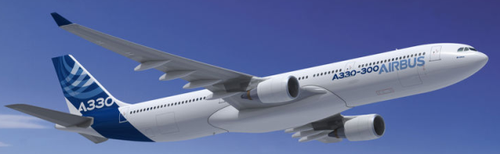
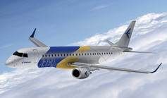
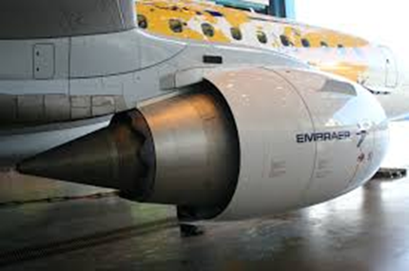
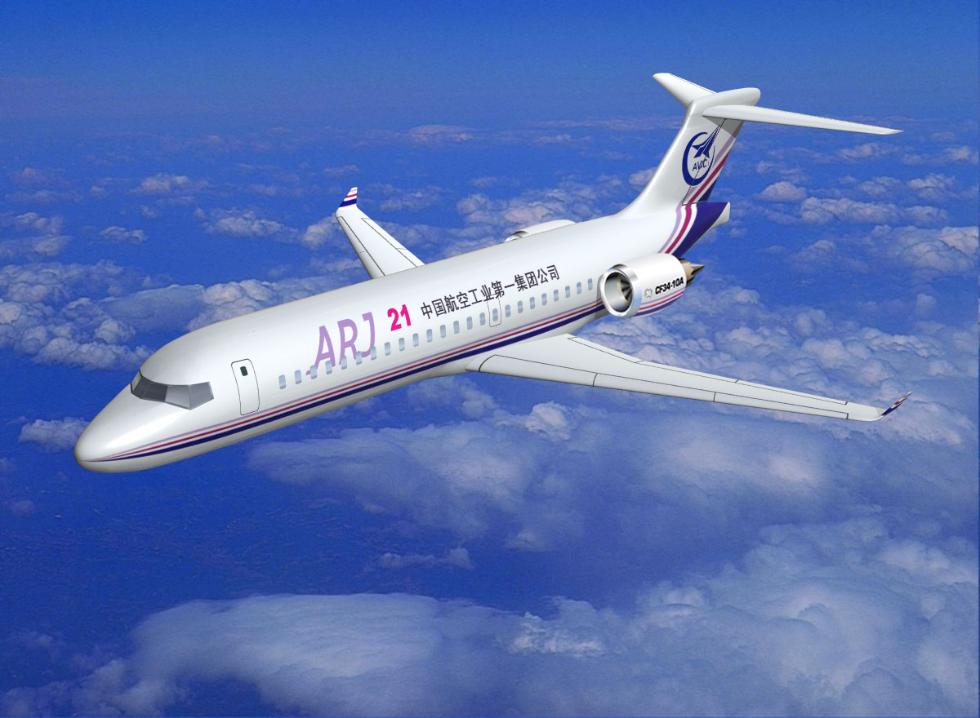
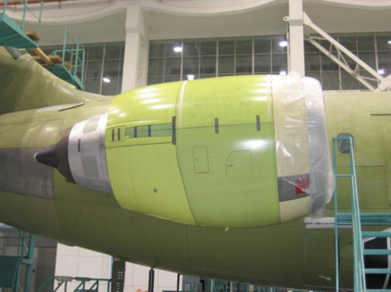
Current Customers & Products
Airbus A300 / 310
Boeing 747 / 767 (incl. Tanker) / MD11
Lockheed C5, Kawasaki C-2 Transport
  CF6-80C2 Thrust Reverser and TRAS
Airbus A330
  CF6-80E Thrust Reverser and TRAS
  Pratt Whitney 4168 Thrust Reverser
Embraer ERJ-190/195
  CF34-10E Thrust Reverser and TRAS
COMAC ARJ-21
  CF34-10A Nacelle (Inlet, Fan Cowl & Thrust reverser with TRAS)

Slide 11
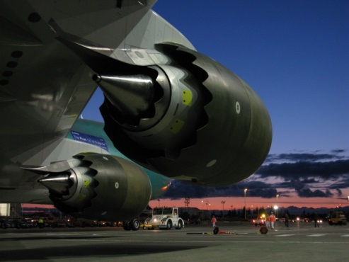
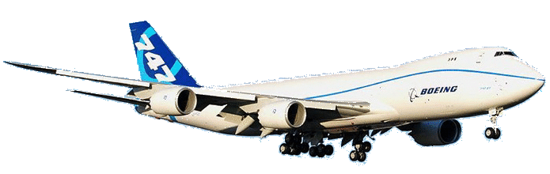
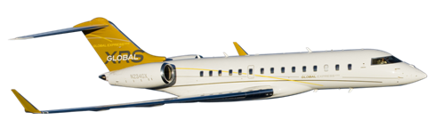
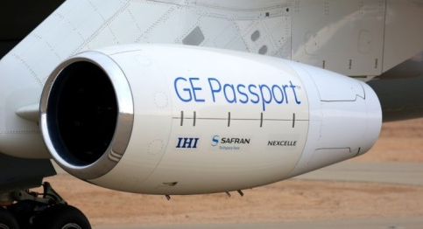
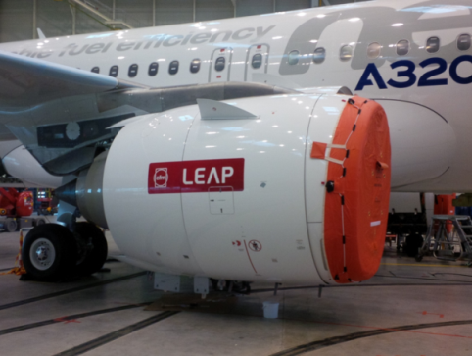
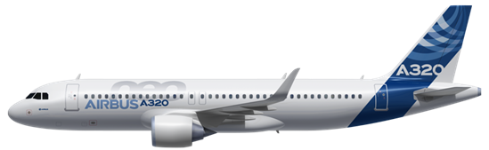
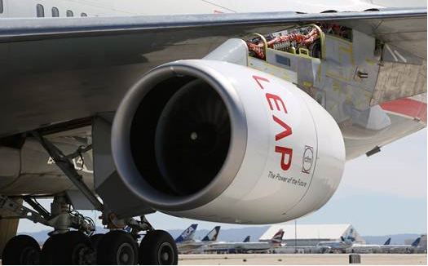

Current Customers & Products
Boeing 747-8
  GEnX-2B Thrust Reverser
Bombardier Global 7000 / 8000
  Passport 20 Inlet, Fan Cowl and TRAS
Airbus A320 NEO
  LEAP-1A Transcowl, TRAS and EBU
COMAC C919
  LEAP-1C Inlet, Fan Cowl, IFS

Slide 12
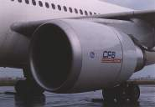
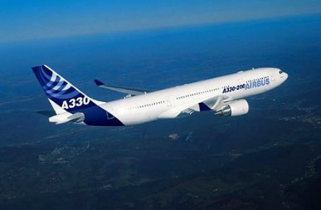
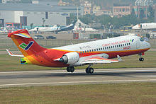
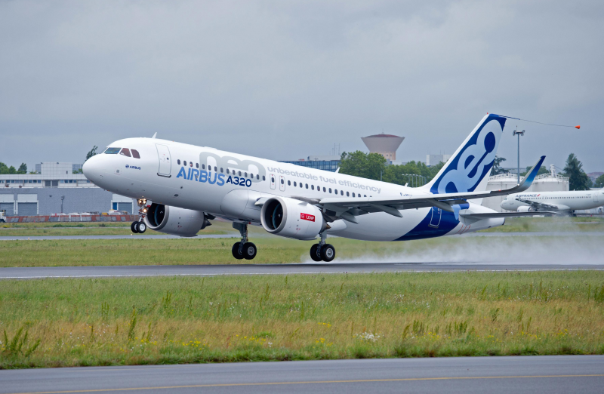
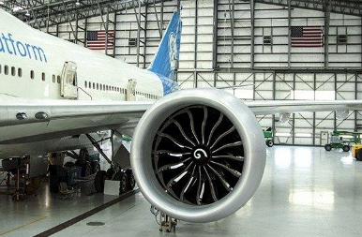
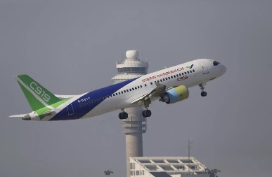
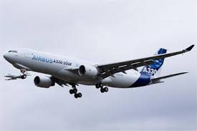
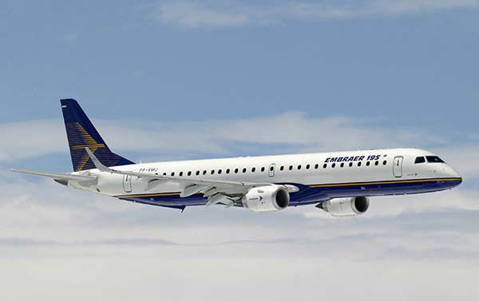
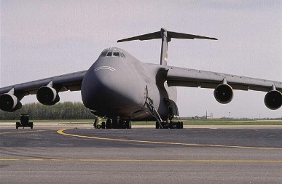
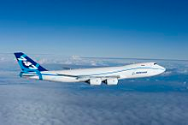
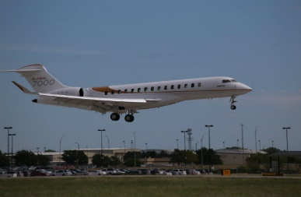
Timeline of Programs
B767 / B747 / MD-11
CF6-80C2
Thrust Reverser
A330
CF6-80E2
Thrust Reverser
ARJ21
CF34-10A
Nacelle
A320neo
LEAP-1A
TC / HTRAS / EBU
777X
GE9X
Fan Case
C919
LEAP-1C
IFS / Inlet / Fan Cowl
1980 | 1985 | 1990 | 1995 | 2000 | 2005 | 2010 | 2015 | 2020
2025 | 2030
A330
PW4168
Thrust Reverser
ERJ190/195
CF34-10E
Thrust Reverser
C5
CF6-80C2L1F
Thrust Reverser
B747-8
GENx-2B
Thrust Reverser
Global 7000
Passport 20
Inlet / Fan Cowl / HTRAS

Slide 13
How do Turbofan engines work?

Slide 14
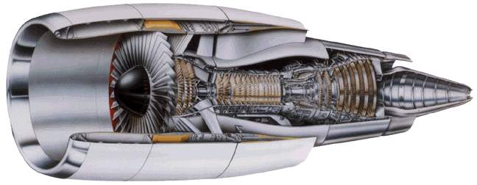
Bypass air
through fan only
(does not get compressed or combusted)
Multi-stage turbine
Multi-stage compressor
Combustor
Core air

Slide 15
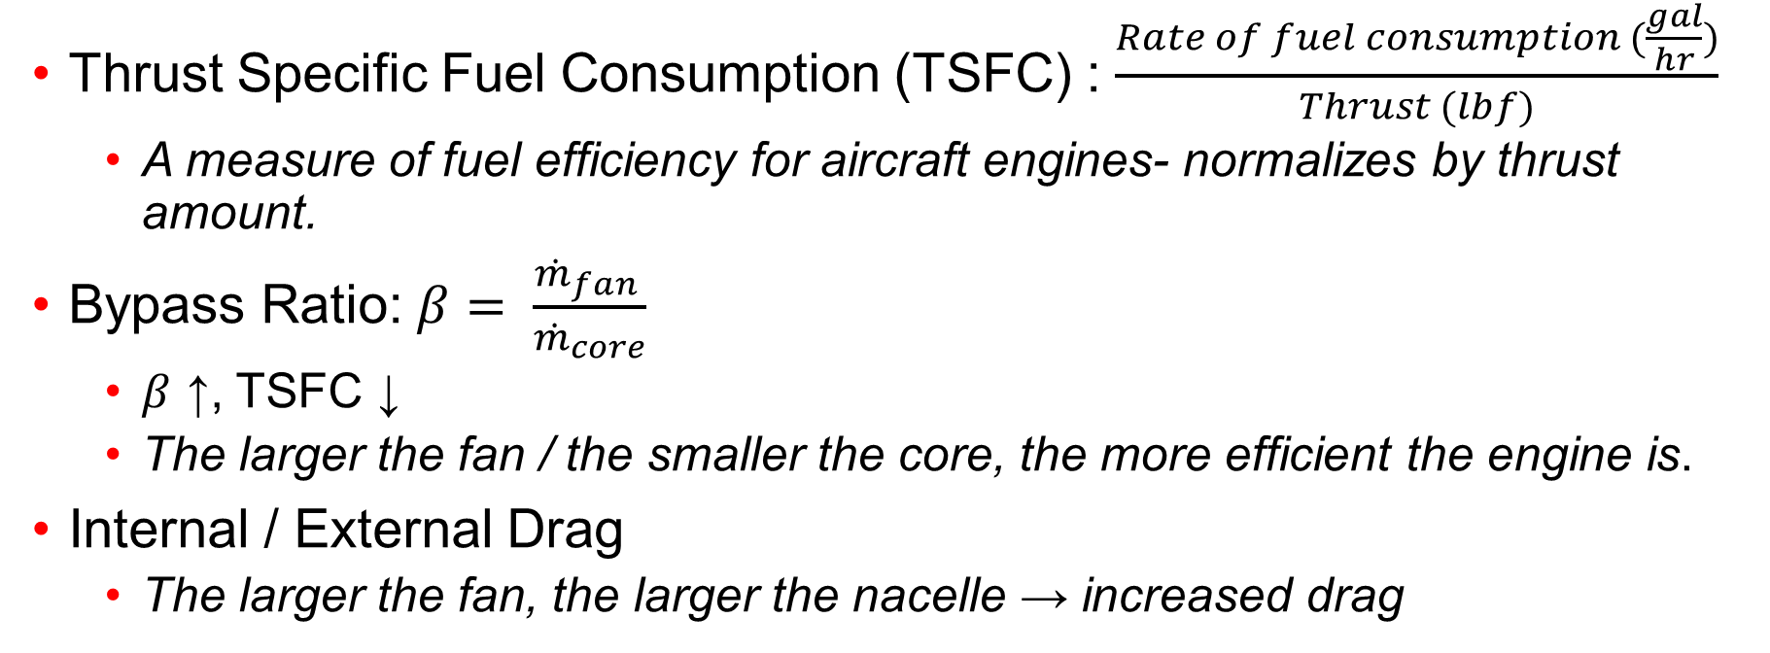
Engine Performance-
Key Parameters
Thrust Specific Fuel Consumption (TSFC) : $\frac{Rate of fuel consumption (\frac{gal}{hr})}{Thrust (lbf)}$
  A measure of fuel efficiency for aircraft engines- normalizes by thrust amount.
Bypass Ratio: $β= \frac{{\dot{m}}_{fan }}{{\dot{m}}_{core}}$
  $β$ ↑, TSFC ↓
  The larger the fan / the smaller the core, the more efficient the engine is.
Internal / External Drag
  The larger the fan, the larger the nacelle → increased drag

Slide 16
What’s a Nacelle?

Slide 17
What’s a Nacelle?
Engine
Aft core cowl
Inlet
Fan cowl
Thrust reverser
The nacelle typically consist on an inlet, fan cowl, thrust reverser, an aft cowl (sometimes an integral part of the thrust reverser), and a primary exhaust

Slide 18
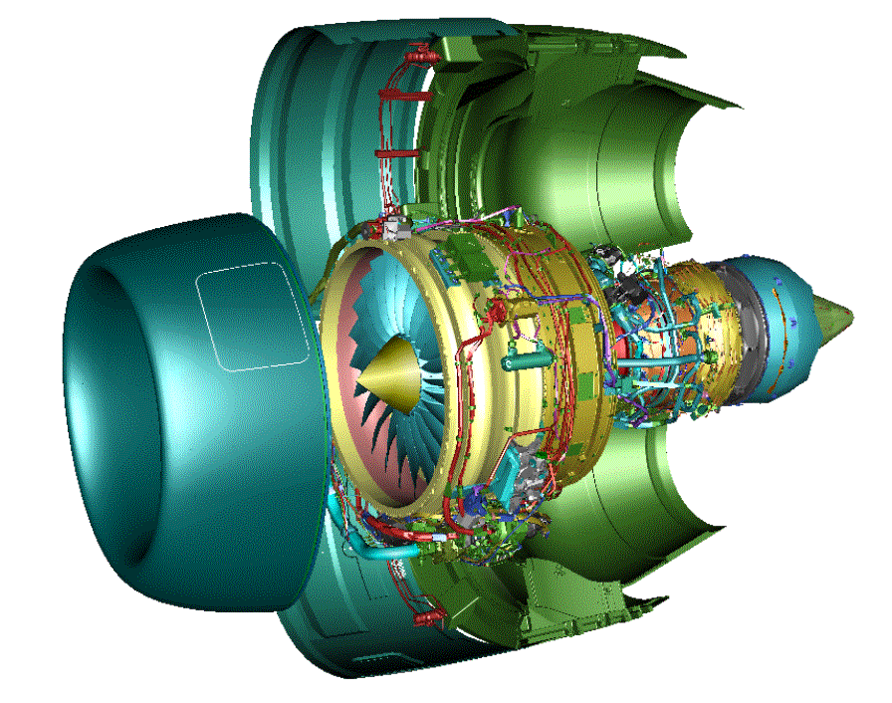
Propulsion System = Nacelle + Engine + EBU
Thrust Reverser
(FAR25 or 33)
Engine Fan Cases
(FAR 33)
EBU Systems
  External Hardware – tubes, brackets, manifolds, heat shields, ducts, flexible joints, clamps for
    Fuel Supply
    Oil Supply, Scavenge, and Vents
    IDG cooling
    Fire protection
    Drains
    Active Clearance Control
    Under cowl Cooling,
    Electrical
    Pneumatic systems (NAI, Starter)
    Cooling Air
    Hydraulic
    Indicating Systems
    Actuation
    Electrical cable routing and support
Inlet
(FAR 25)
Core Nozzle
(FAR 25 or 33)
Engine Core
(FAR33)
Fan Cowl
(FAR 25)

Slide 19
What’s the purpose of a Nacelle?
Provide acoustic treatment for noise attenuation
Provide a fan duct to efficiently guide airflow to a thrust producing nozzle
Provide a duct to guide core airflow through a nozzle
Provide an inlet to smoothly guide airflow into the front of the engine
Provide fire zone boundaries for fire containment
Provide an external fairing to minimize aircraft drag
Includes a thrust reversal mechanism

Slide 20
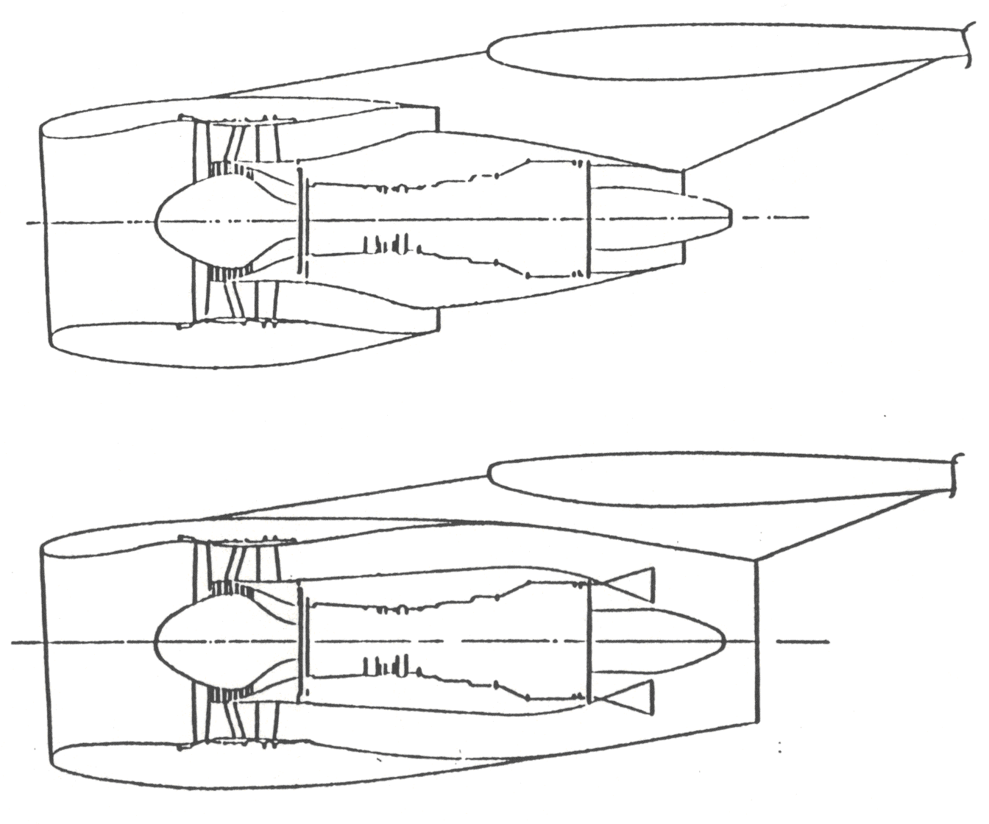
Common Types of Nacelle
Short Duct Separate Flow Nacelles (SDSF)
Commonly uses thrust reverser variations with or without blocker doors
Pictures depict under wing mounted propulsion system
Long Duct Mixed Flow Nacelles (LDMF)
Commonly uses pivot door or target thrust reverser variations

Slide 21
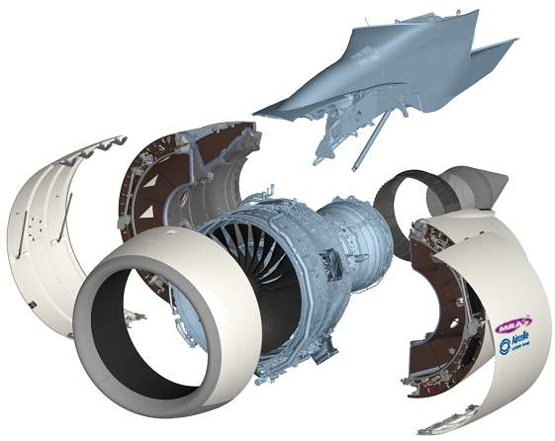
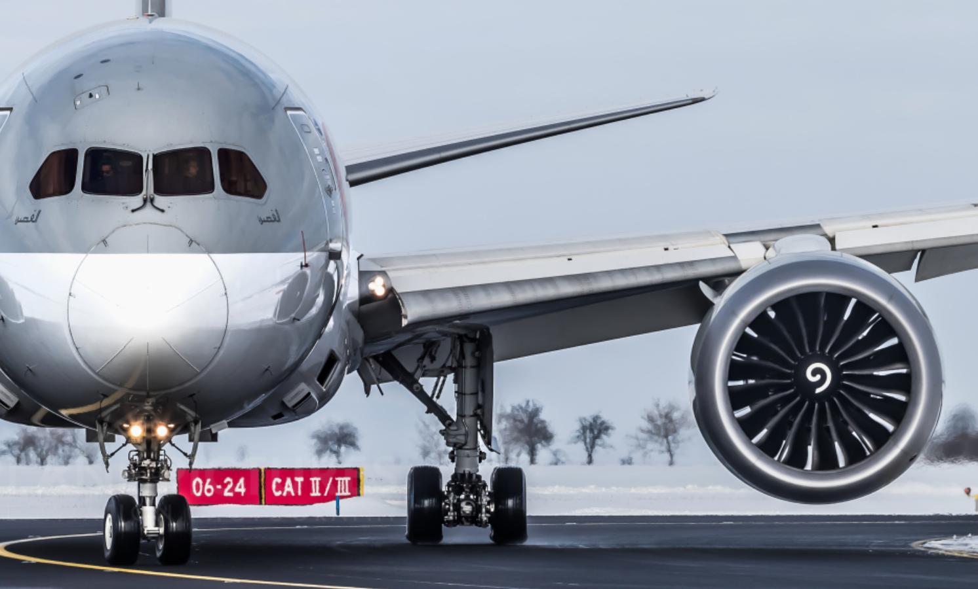
Under Wing Mounted Nacelle D-Duct
Pylon
Thrust
Reverser
Primary Exhaust
Fan Cowl
PW4168, A320neo, CF6, CF34-10E, 747-8
Inlet

Slide 22
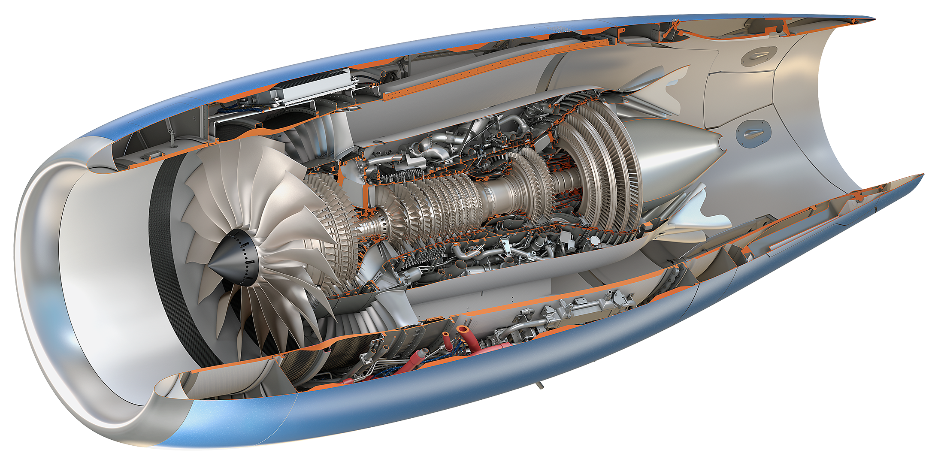
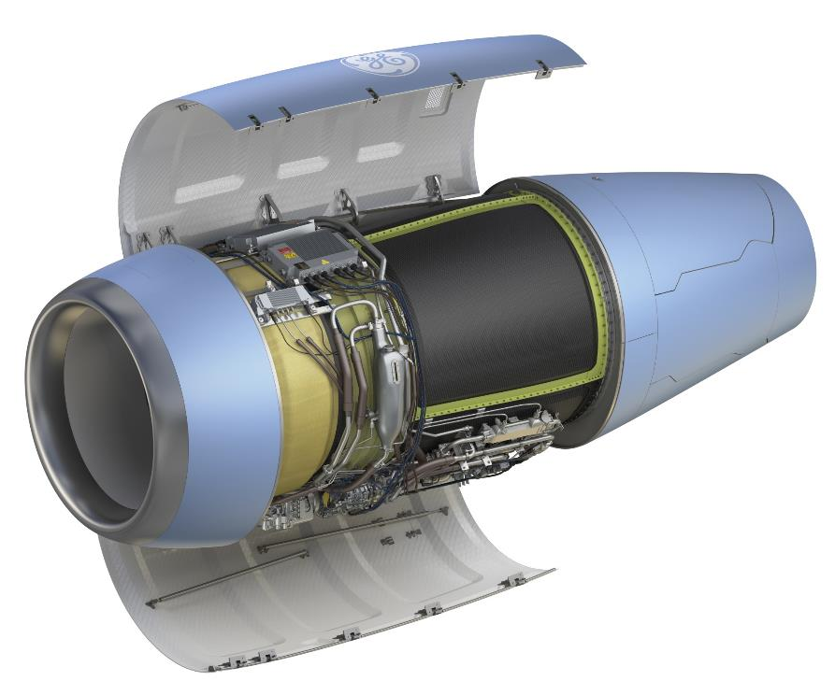
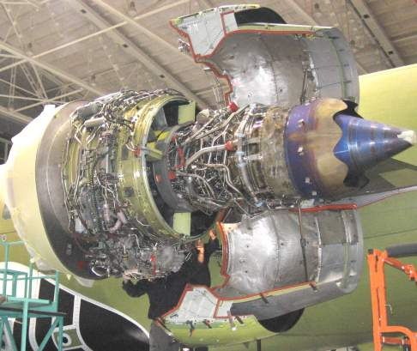
Fuselage Mounted Nacelle
LDMF nacelle shown with fan cowl doors opened on right
PP20
Closed
Open
SDSF nacelle shown with thrust reverser in the open position and fan cowl door removed
CF34-10A

Slide 23
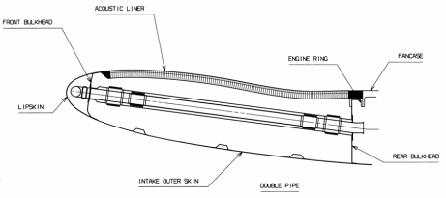
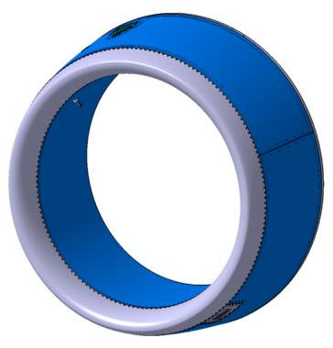
Inlet Key Functions and Requirements
Provide an aerodynamic flow surface to direct airflow to engine fan
Provide anti icing of the forward lip
Bird Strike protection to allow aircraft to fly home safely
Provide a fire wall to the front boundary of the fan compartment (if fan compartment is a fire zone)
Provide for cooling flow into the fan compartment
FADEC cooling (depends on engine configuration)
Provide protection against lightning strike
Hoist point fittings for installation ease to aircraft
Fan Compartment
Ventilation Inlet
2-piece
Outer Barrel
T12 Probe
Interface
Inlet Lip
Inner Barrel
Nacelle Anti-Ice Exhaust

Slide 24
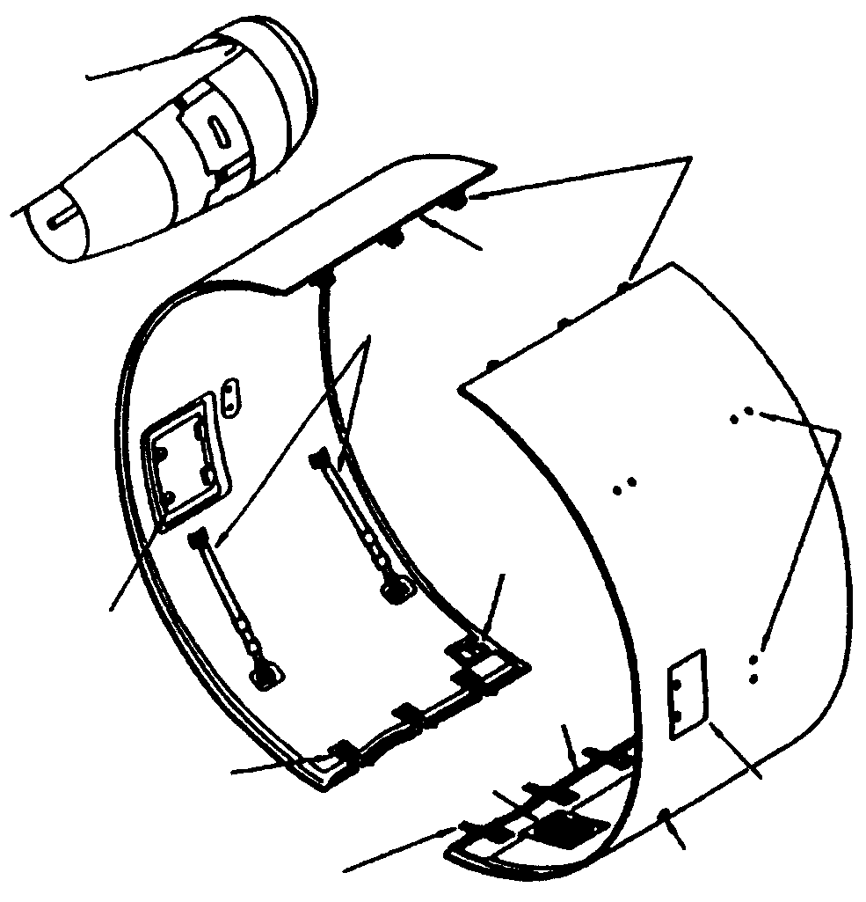
Fan Cowl Key Functions and Requirements
Provide an aerodynamic flow surface between the inlet and thrust reverser
  Must meet required steps and gap to inlet, pylon structure and thrust reverser
Provide quick & easy access to engine components for maintenance
  Oil tank check and fill
  Starter valve
  Access to engine FADEC, gearbox, pumps, oil filter, etc.
Provide a fire wall (if fan compartment is a fire zone) to help contain the spread of a fire to protect pylon structure
  Limit release of fire extinguishing fluid during a fire
Provide ventilation (inlet and/or exhaust) of the fan compartment
Provide ventilation (typically with a pressure relief door) after an over pressurization event (i.e. burst duct)
Provide protection against lightning strike and HIRF
Allow for drainage of engine fluid, including a burst flammable fluid line
Hoist point fittings for installation ease to aircraft
A
Hinge
Fittings
A
Cowl
Door
Hold
Open
Rods
Hoist
Points
Cooling
Inlet
Engine Oil Fill Access
Door
Adjustable
Eyebolt
Compartment
Cooling
Outlet
Pressure Relief
Door
Latches
Starter Valve
Handle Access

Slide 25
Thrust Reverser Key Functions and Requirements
Provide a fan duct to efficiently guide airflow through fan duct exit plane for SDSF applications or to a mixer & mixed flow nozzle for LDMF applications
Provide an external aerodynamic fairing for the propulsion system to minimize aircraft drag
Provide a fire wall for the engine core compartment to help contain the spread of an engine fire
Provide a place to house acoustic treatment for the attenuation of engine noise
Provide a thrust reversal mechanism to help decelerate the aircraft
Provide access to the engine core for engine maintenance activity
Provide protection against lightning strike

Slide 26
Why Have a Thrust Reverser?
Safety
  Aids stopping in adverse conditions
Airline maintenance cost reduction
  Reduces wear on brakes and tires→ less replacements
Airline operational reasons
  Allows for shorter landings, quicker time to gate, and reduced cooldown time

Slide 27
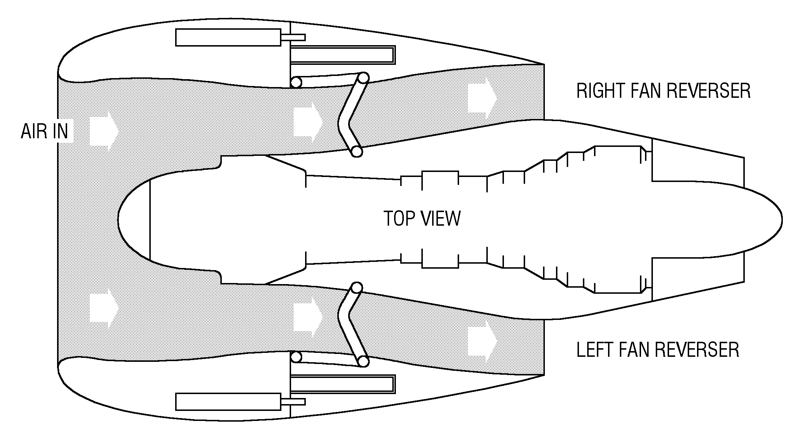
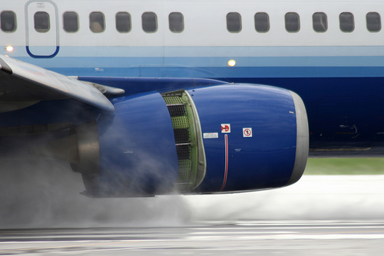
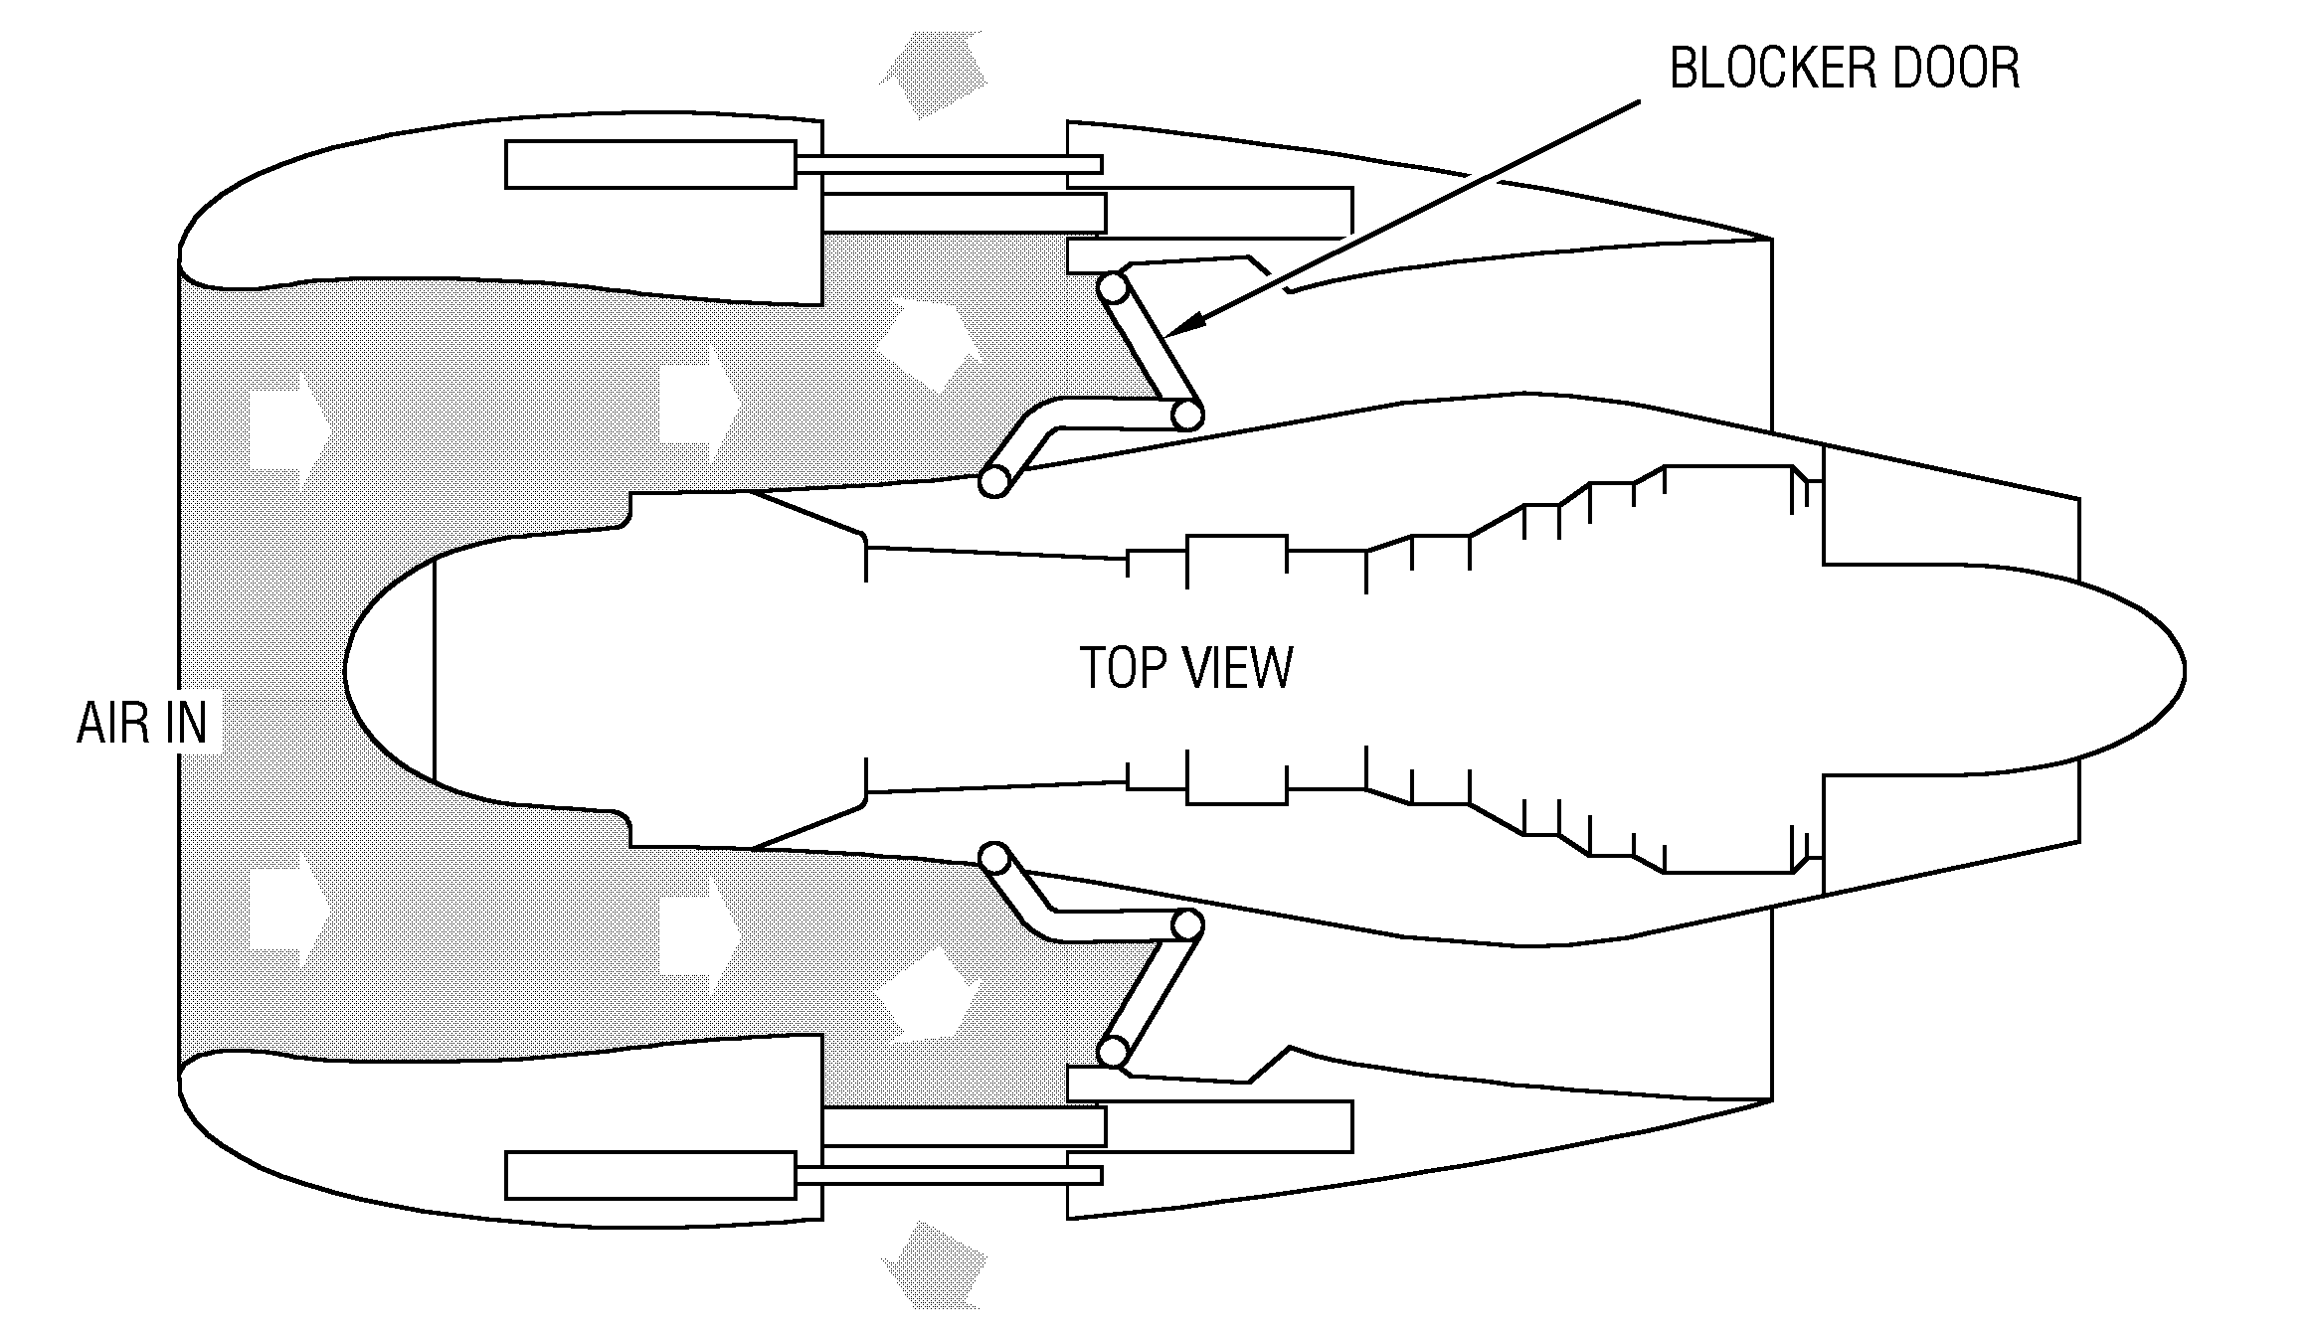
Short Duct Separate Flow Thrust Reverser
Cascades

Slide 28
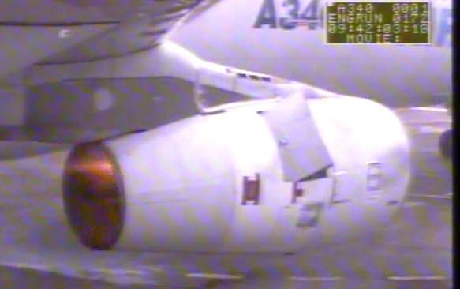



Long Duct Mixed Flow Thrust Reverser

Slide 29

Stowed

Slide 30

50% Deployed

Slide 31

100% Deployed

Slide 32


Primary (Core) Exhaust
Key functions and requirements
Provide aerodynamic surfaces to guide the engine core exhaust flow and generate thrust, while minimizing drag
  For high-bypass commercial engines, the core exhaust generates ~10% of overall thrust, the other 90% comes from the fan.
For some applications- provide acoustic treatment to attenuate engine noise
Provide a fire barrier between the engine and the aircraft pylon

Slide 33

Primary exhaust cross section

Slide 34
Career

Slide 35



Career Path
Graduated December 2016
Retail / Restaurant work from December 2016 to October 2017
  Pappas Restaurant, Weis Markets, Amazon Warehouse (yes, it is that bad)
October 2017- February 2018: Belcan, Engineering Technician in MRAS engineering test lab (Contractor)
  Translate drawings & models into step-by-step instructions for development / certification test articles
  Process development
    GE9X case wrap / abradable bond NDI standards
    GE scaled acoustic testing
  Production / Lab tool design
    Various carts and safety guards
February 2018- June 2021: Design Engineer (sustaining programs)
June 2021- Promoted to Lead Design Engineer (sustaining programs)
Jan 2022- Lead Design Engineer on an NPI Program (Large commercial cargo aircraft)

Slide 36

What do I do as a Lead Design Engineer?
Day to Day:
  Design stuff!
    Modifying existing designs and creating brand-new designs
    Root cause investigations for in service / manufacturing issues
  Consult with other functions to ensure the best possible product (manufacturing, M&P, stress, thermal, certification, quality, sourcing, etc).
  3D modeling, drafting, specification writing, test plans / reports, technical presentations... etc
  Support internal and external technical topics (meetings, design reviews, etc).
Within the company:
  Serve as the primary technical contact on assigned programs / modules
    Includes engine / airframe customer queries and issues
    Includes occasional business travel
  Onboard / Train / Mentor new-hire design engineers and engineering interns
  Review the work of other internal and external engineers (contractors / suppliers)
    Delegate tasks as needed
  Develop design tools (model templates, spreadsheet calculators, etc) to automate and standardize design tasks

Slide 37


Career Highlight-
Singapore Airshow Display
Had the opportunity to design and assemble a full-scale nacelle display for the Singapore Airshow
  Blank sheet of paper in September, fully assembled in December!
  Traveled to Singapore to assemble the display
    Flew on the longest commercial flight in operation (non-stop 18.5 hours Singapore -> NYC)
  Worked closely with manufacturing, tooling, shop mechanics, suppliers
  Very hands-on, fast-moving project
The display is now permanently installed on the shop floor!

Slide 38



Slide 39
Career Advice
Get as much practical, hands-on experience as you can
  Highly recommend joining a student-led design competition team (DBF / Formula SAE, human powered vehicle, etc.)
Do not undervalue a “foot in the door”
  My first position allowed me to showcase my skills and move into the role/discipline I wanted
  You’re never “stuck” in any discipline- people move around all the time!
Network – both in school and after graduation
  Nobody can do their job 100% on their own- build relationships within your discipline and outside of it!

Slide 40
We’re Hiring!
Currently a few open positions for entry level engineers
  Thermal Analysis Engineer https://talent.paylocity.com/Talent/Jobs/Details/1373031
  Assembly Manufacturing Engineer
  https://talent.paylocity.com/Talent/Jobs/Details/1264821
MRAS normally offers summer internship programs as well
  Normally post around the March / April timeframe

Slide 41
Q&A

