Slide 1
Letter to my Future Self

Slide 2
What is OCSS?
OCSS stands for Off campus student services. We serve 4 populations: Transfers, Veterans, Adult learners (Anyone over 25 years old) and Commuters. OCSS is packed with an amazing staff that’s here for you.

Slide 3
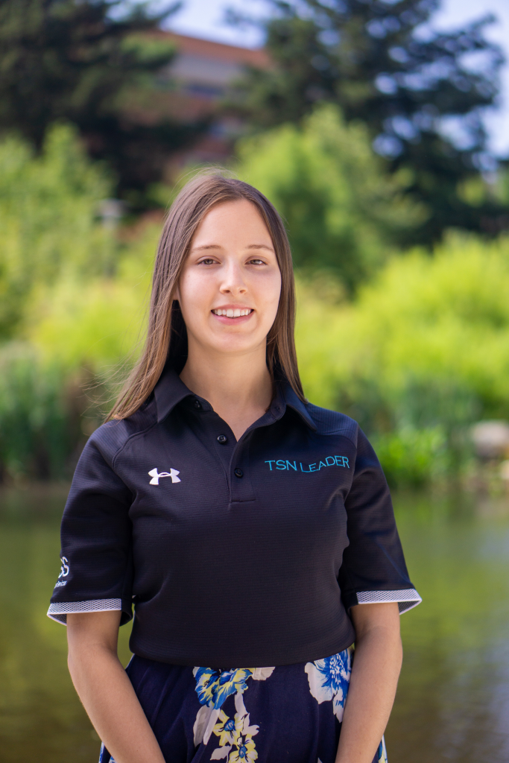
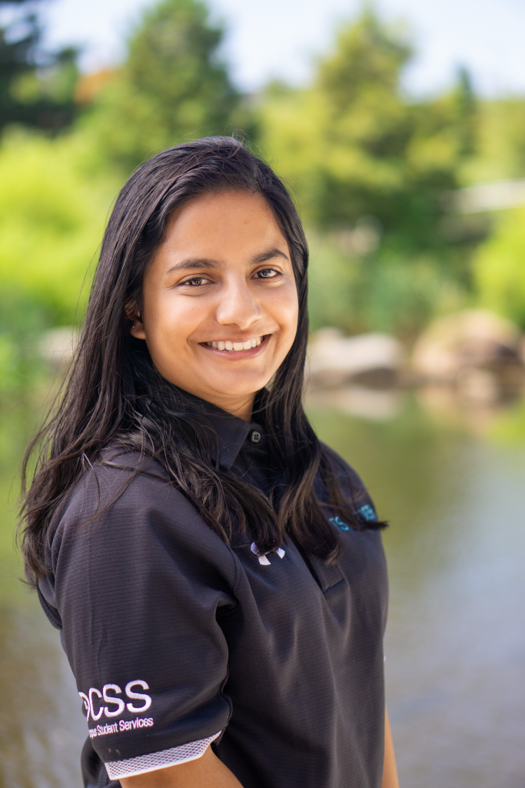
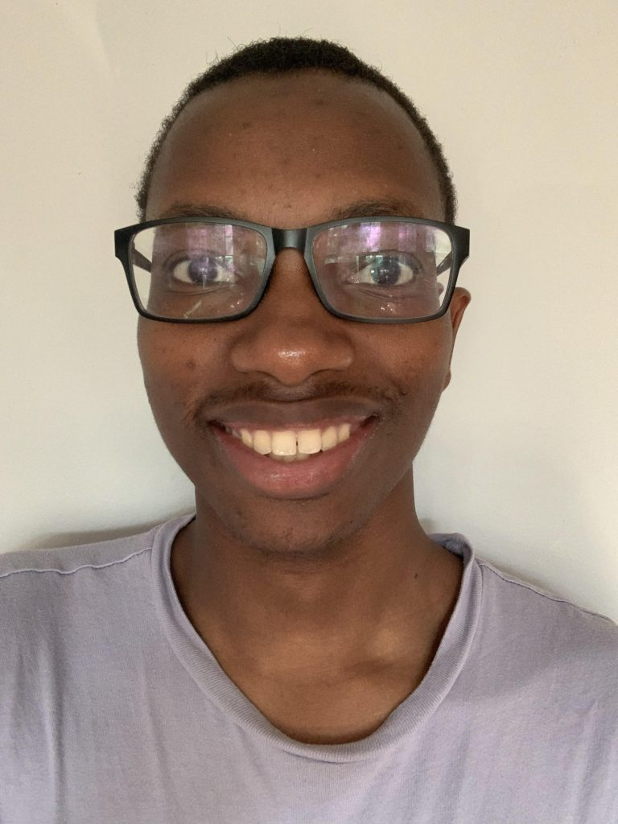
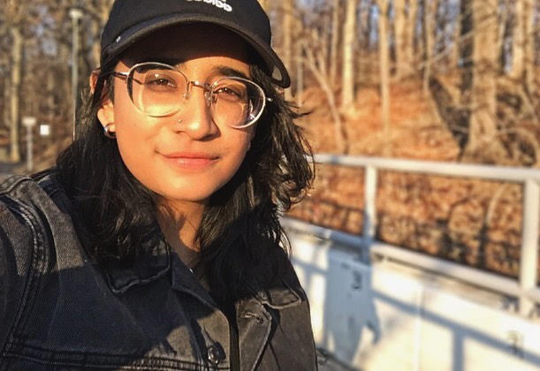
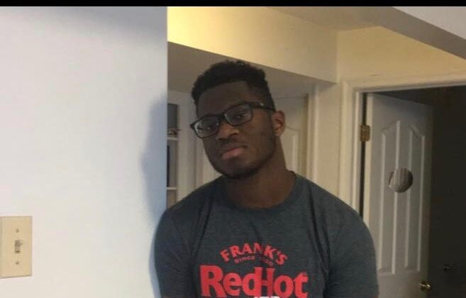
Transfer Student Network Leaders
(TSNs)
Emiley Sale
Anya Hossaini
Henri Maindidze
Asiyah Bora
Emeka Nwosu
Major: Business Technology
Major: CS
Major: Psychology
Major: Pre med & Public Health
Major: Business Technology

Slide 4
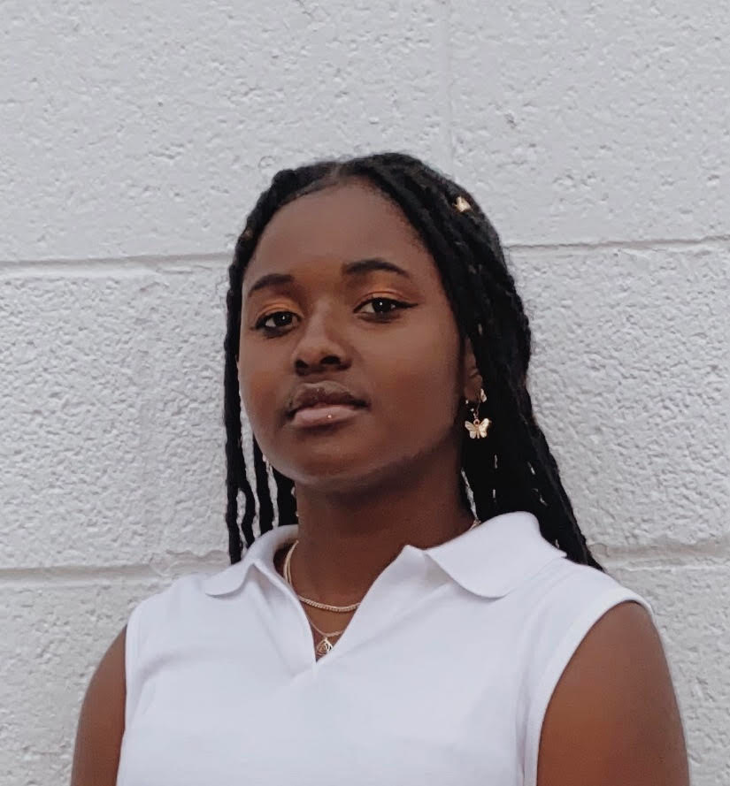
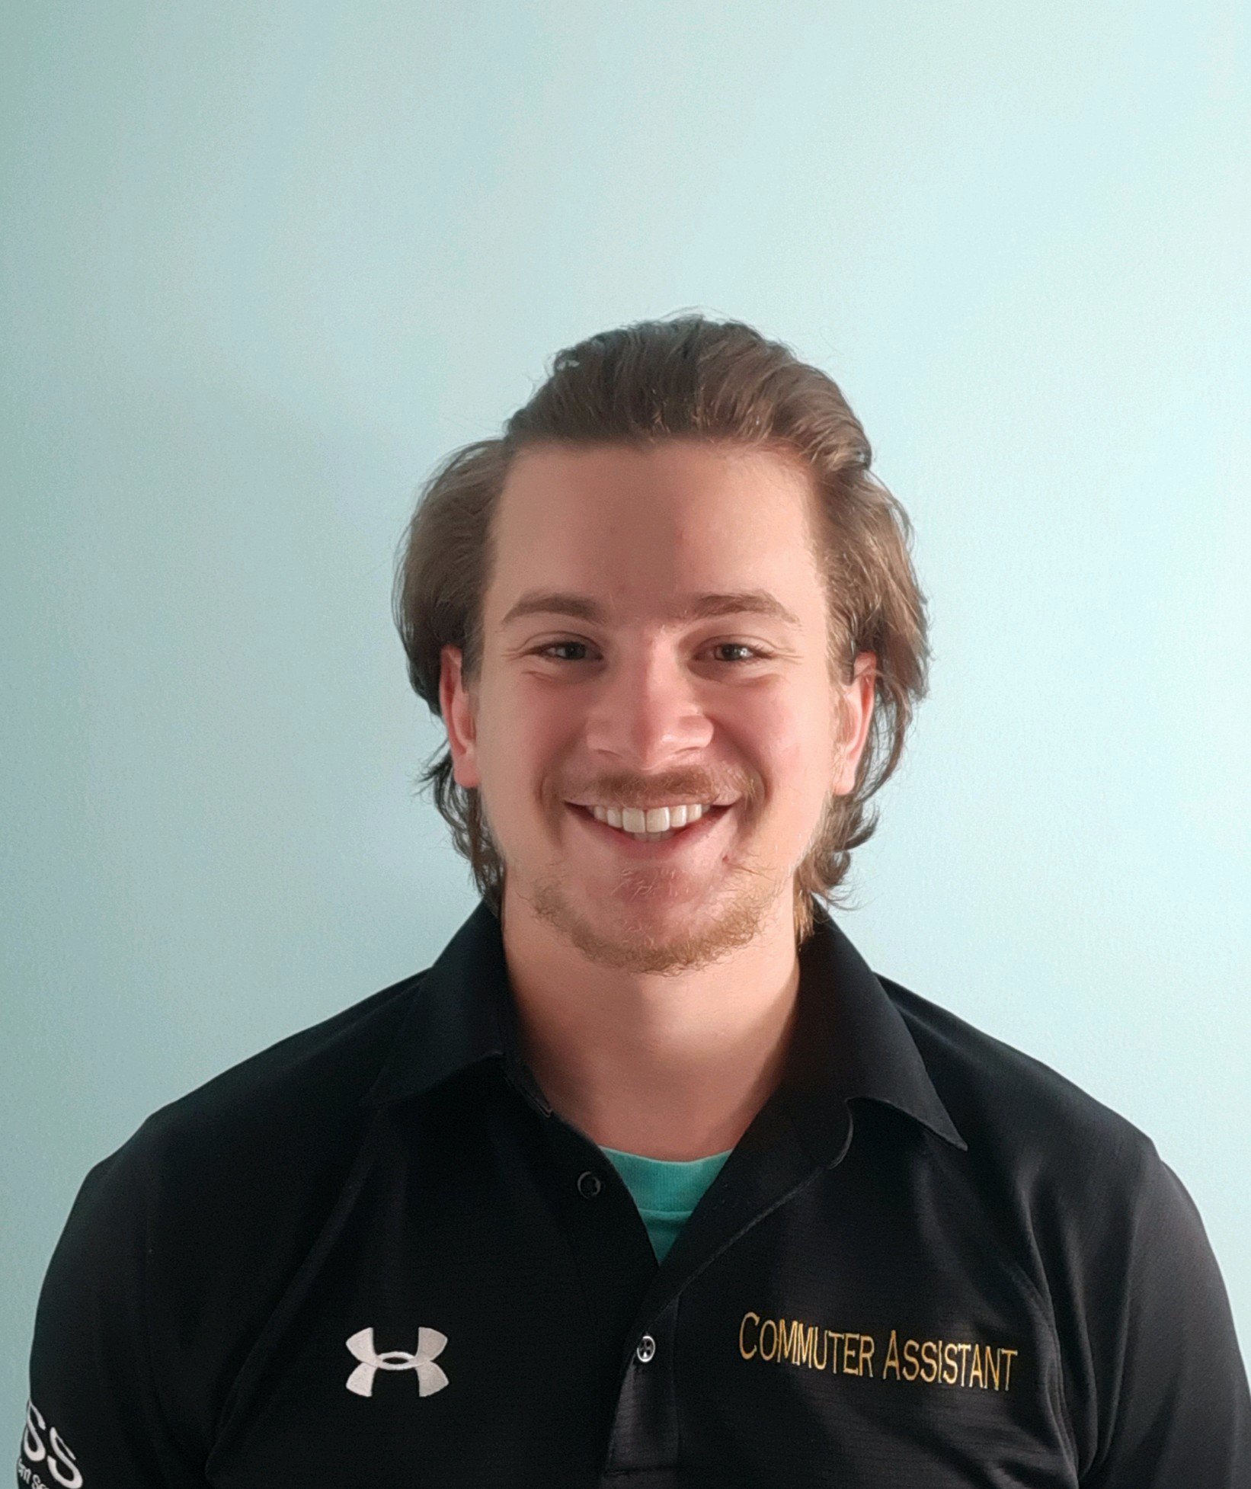
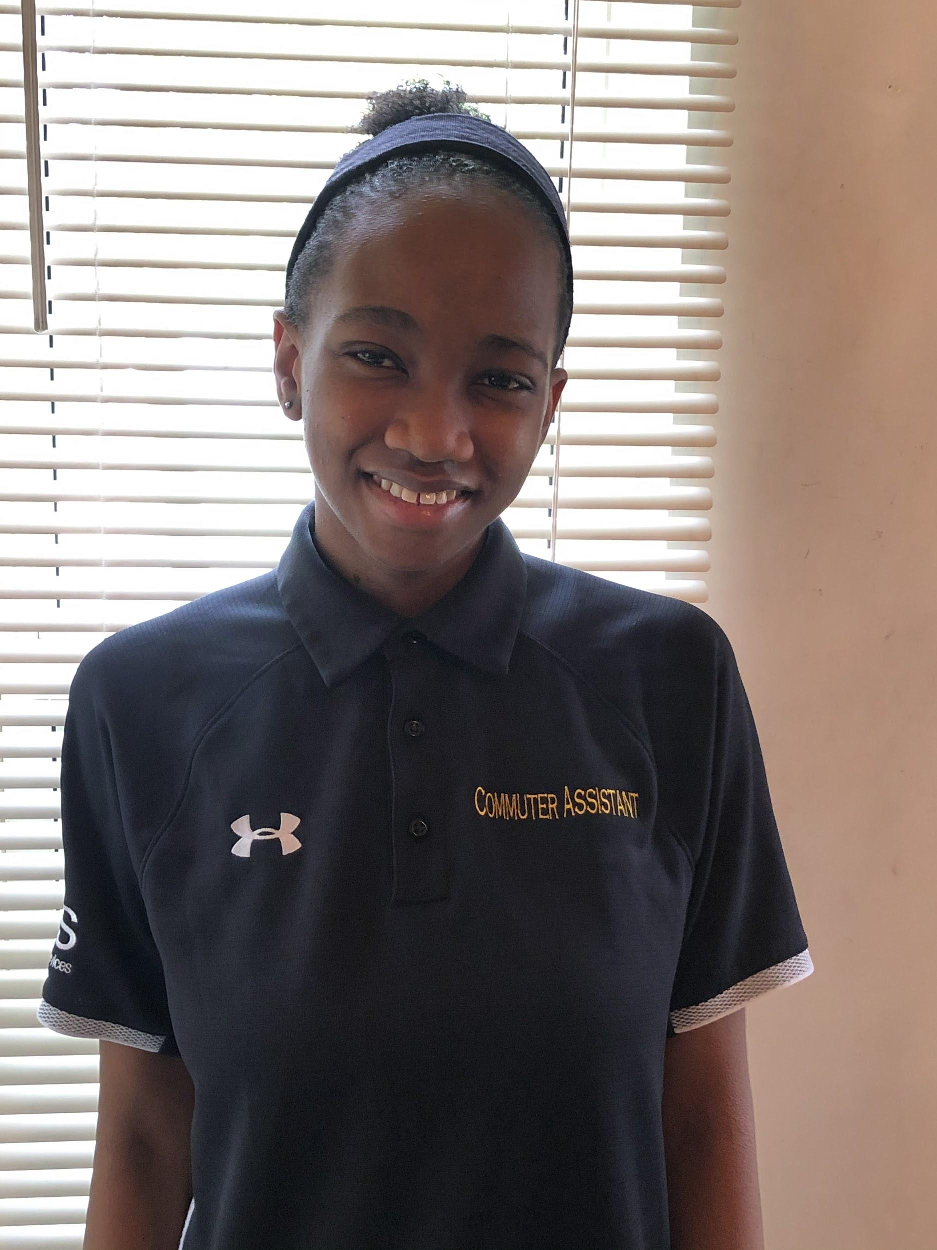
Commuter Assistants (CAs)
Aria Grizzel
Samuel Murril
Kayleigh Nelson
Major: Chemical Engineering
Major: Media & Communications
Major: Global Studies

Slide 5
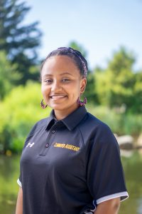
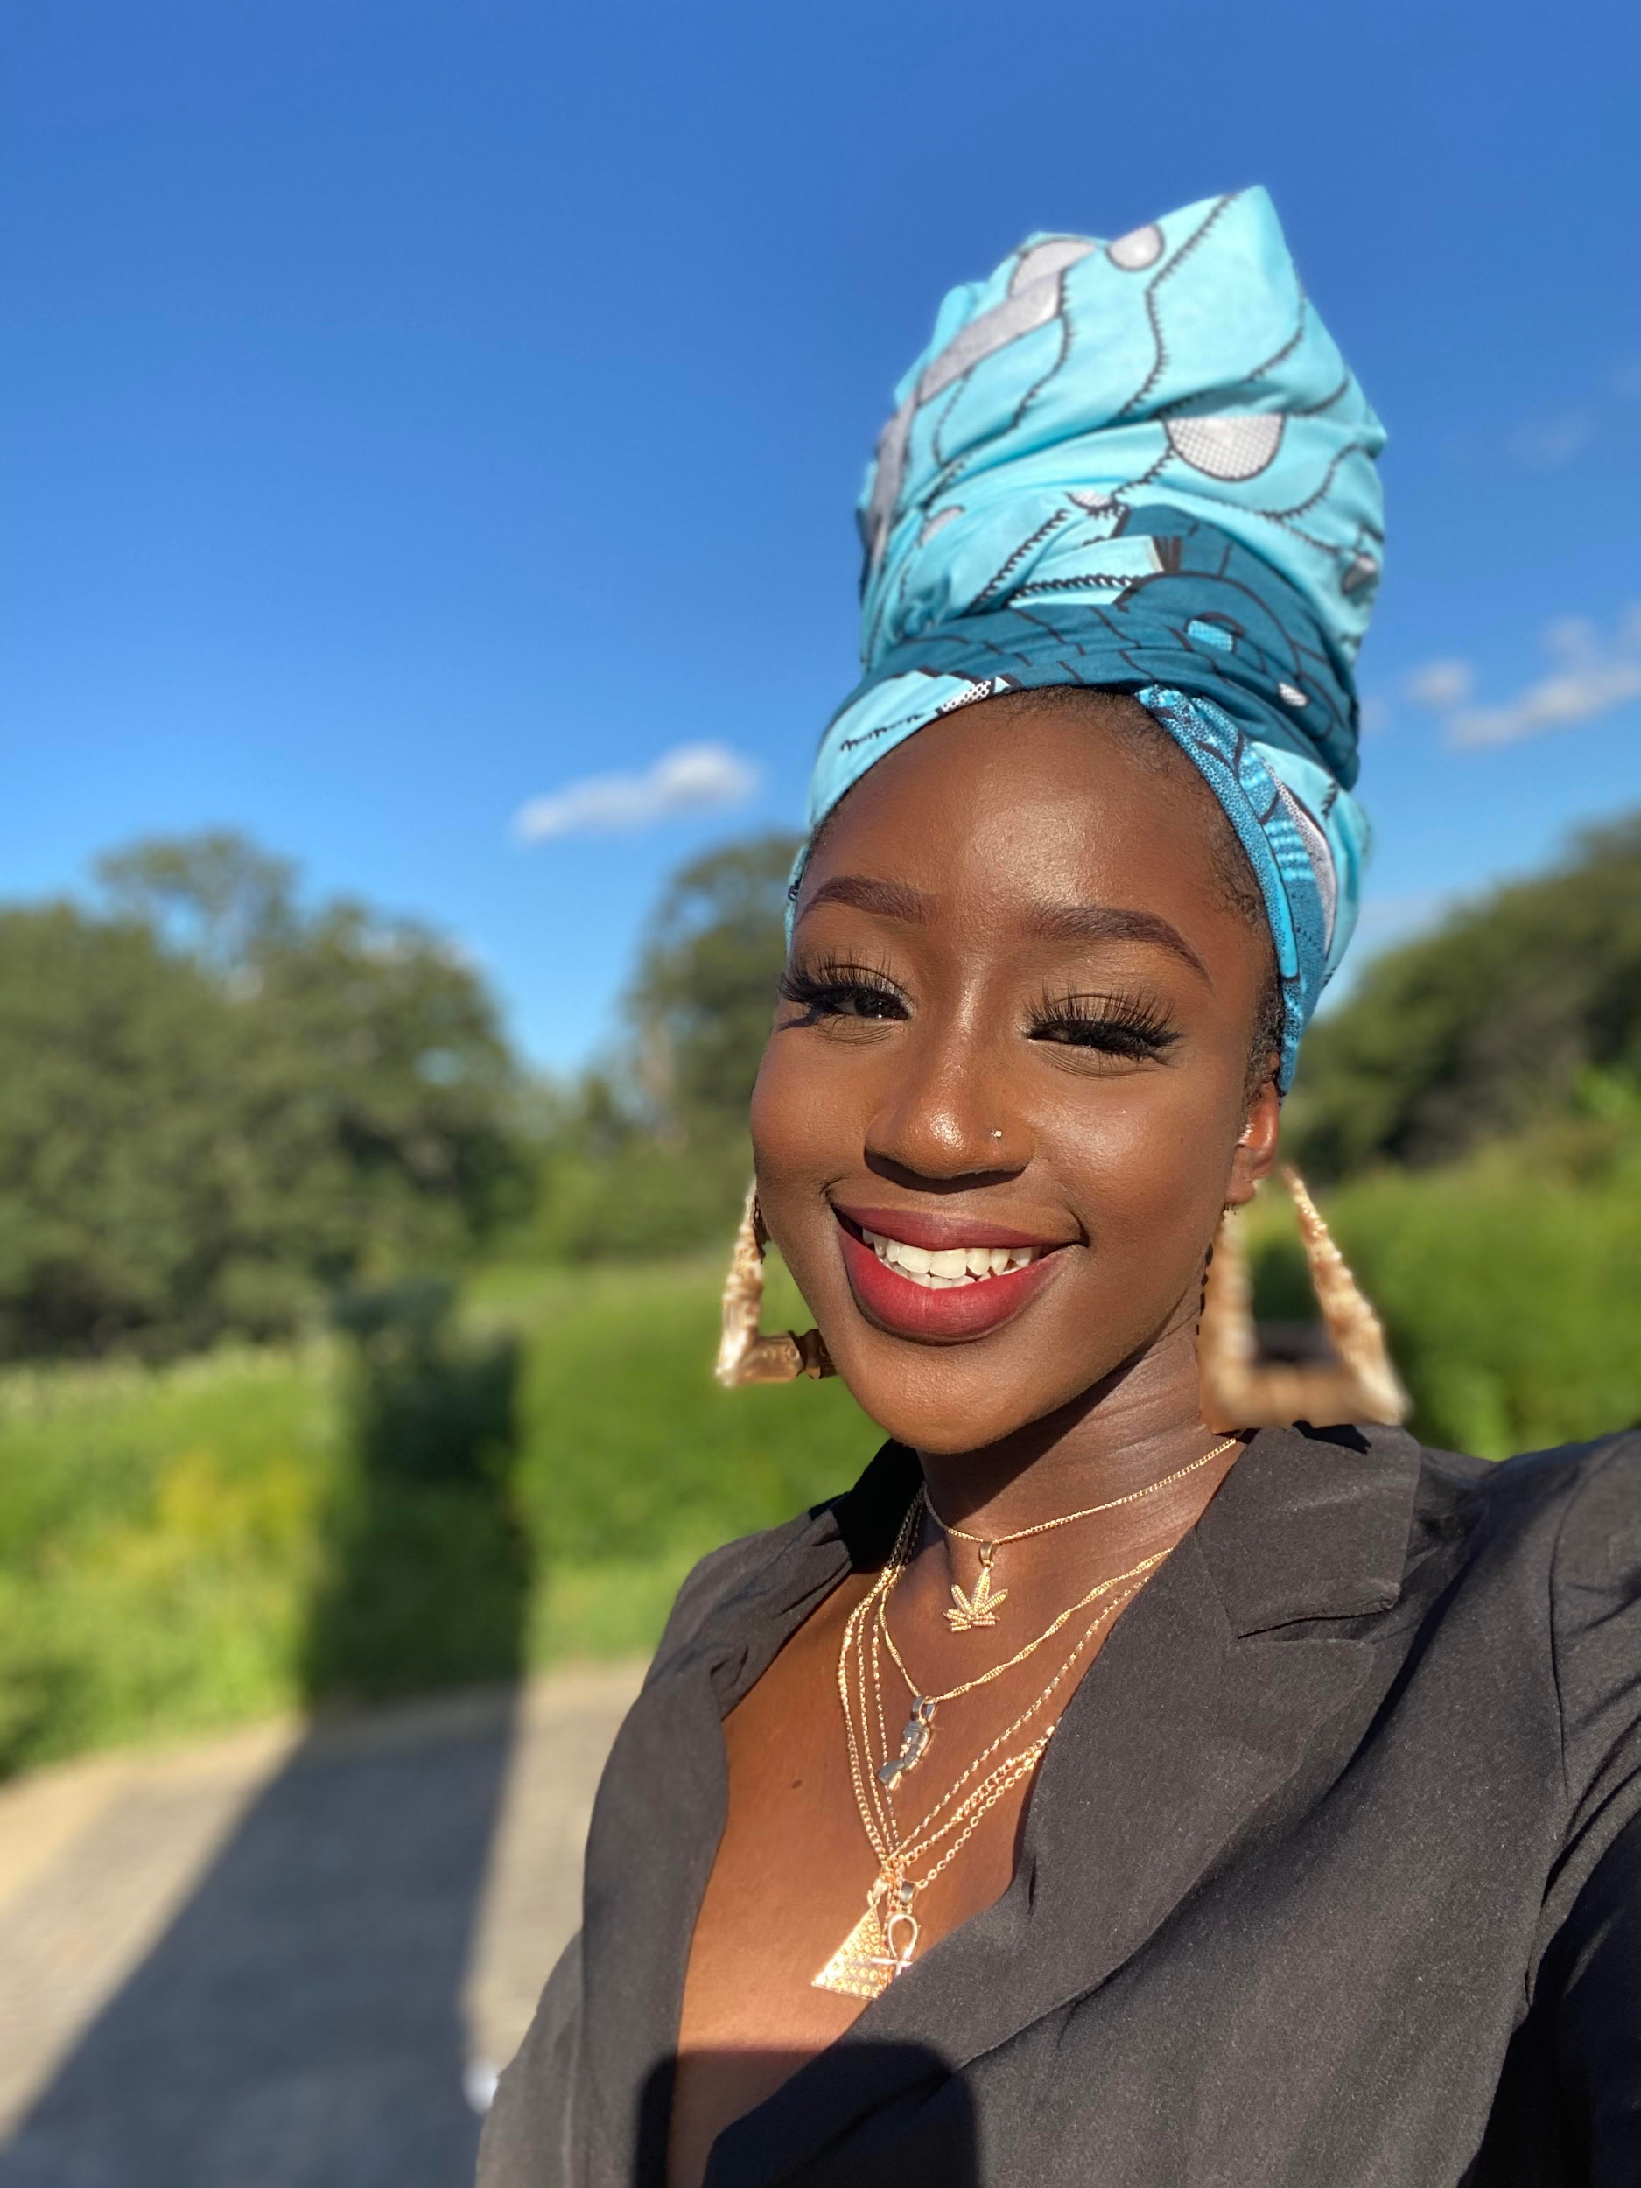
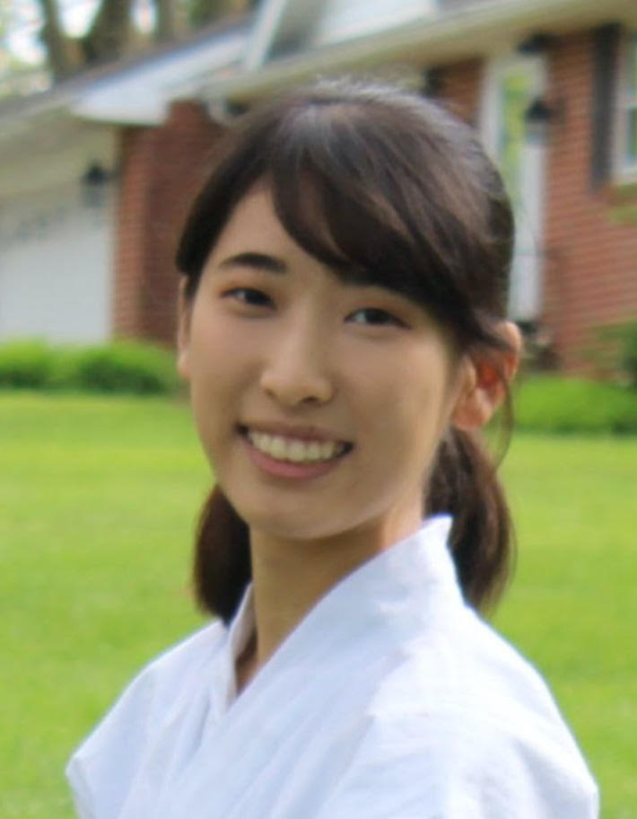
Commuter Assistants (Continued)
Mastewal Hunde
Uche Anaeto
Reina Maeda
Major: Mech Engineer
Major: Biology
Major: Financial Economics

Slide 6
What we will be doing today
We will be writing a letter to our future self. This activity is a great way to enhance your self-awareness and to get you thinking more about your future goals.
We will be using the following website to write our letter: https://www.futureme.org/
Select a date, put in your email and the website will email your letter to you on the date that you specified!
More info on how to use this template at www.slidescarnival.com/help-use-presentation-template
This template is free to use under Creative Commons Attribution license. You can keep the Credits slide or mention SlidesCarnival and other resources used in a slide footer.

Slide 7
What resources at UMBC can help me start achieving my goals?

Slide 8
The Career Center
Utilize the Career Center to land an internship, a part-time job or a full-time job
Schedule an appointment with resume/cover letter review
Information on upcoming events with potential employers
Interviewing and networking tips
And much more!
Notes:
UMBC Career Center link: https://careers.umbc.edu/

Slide 9
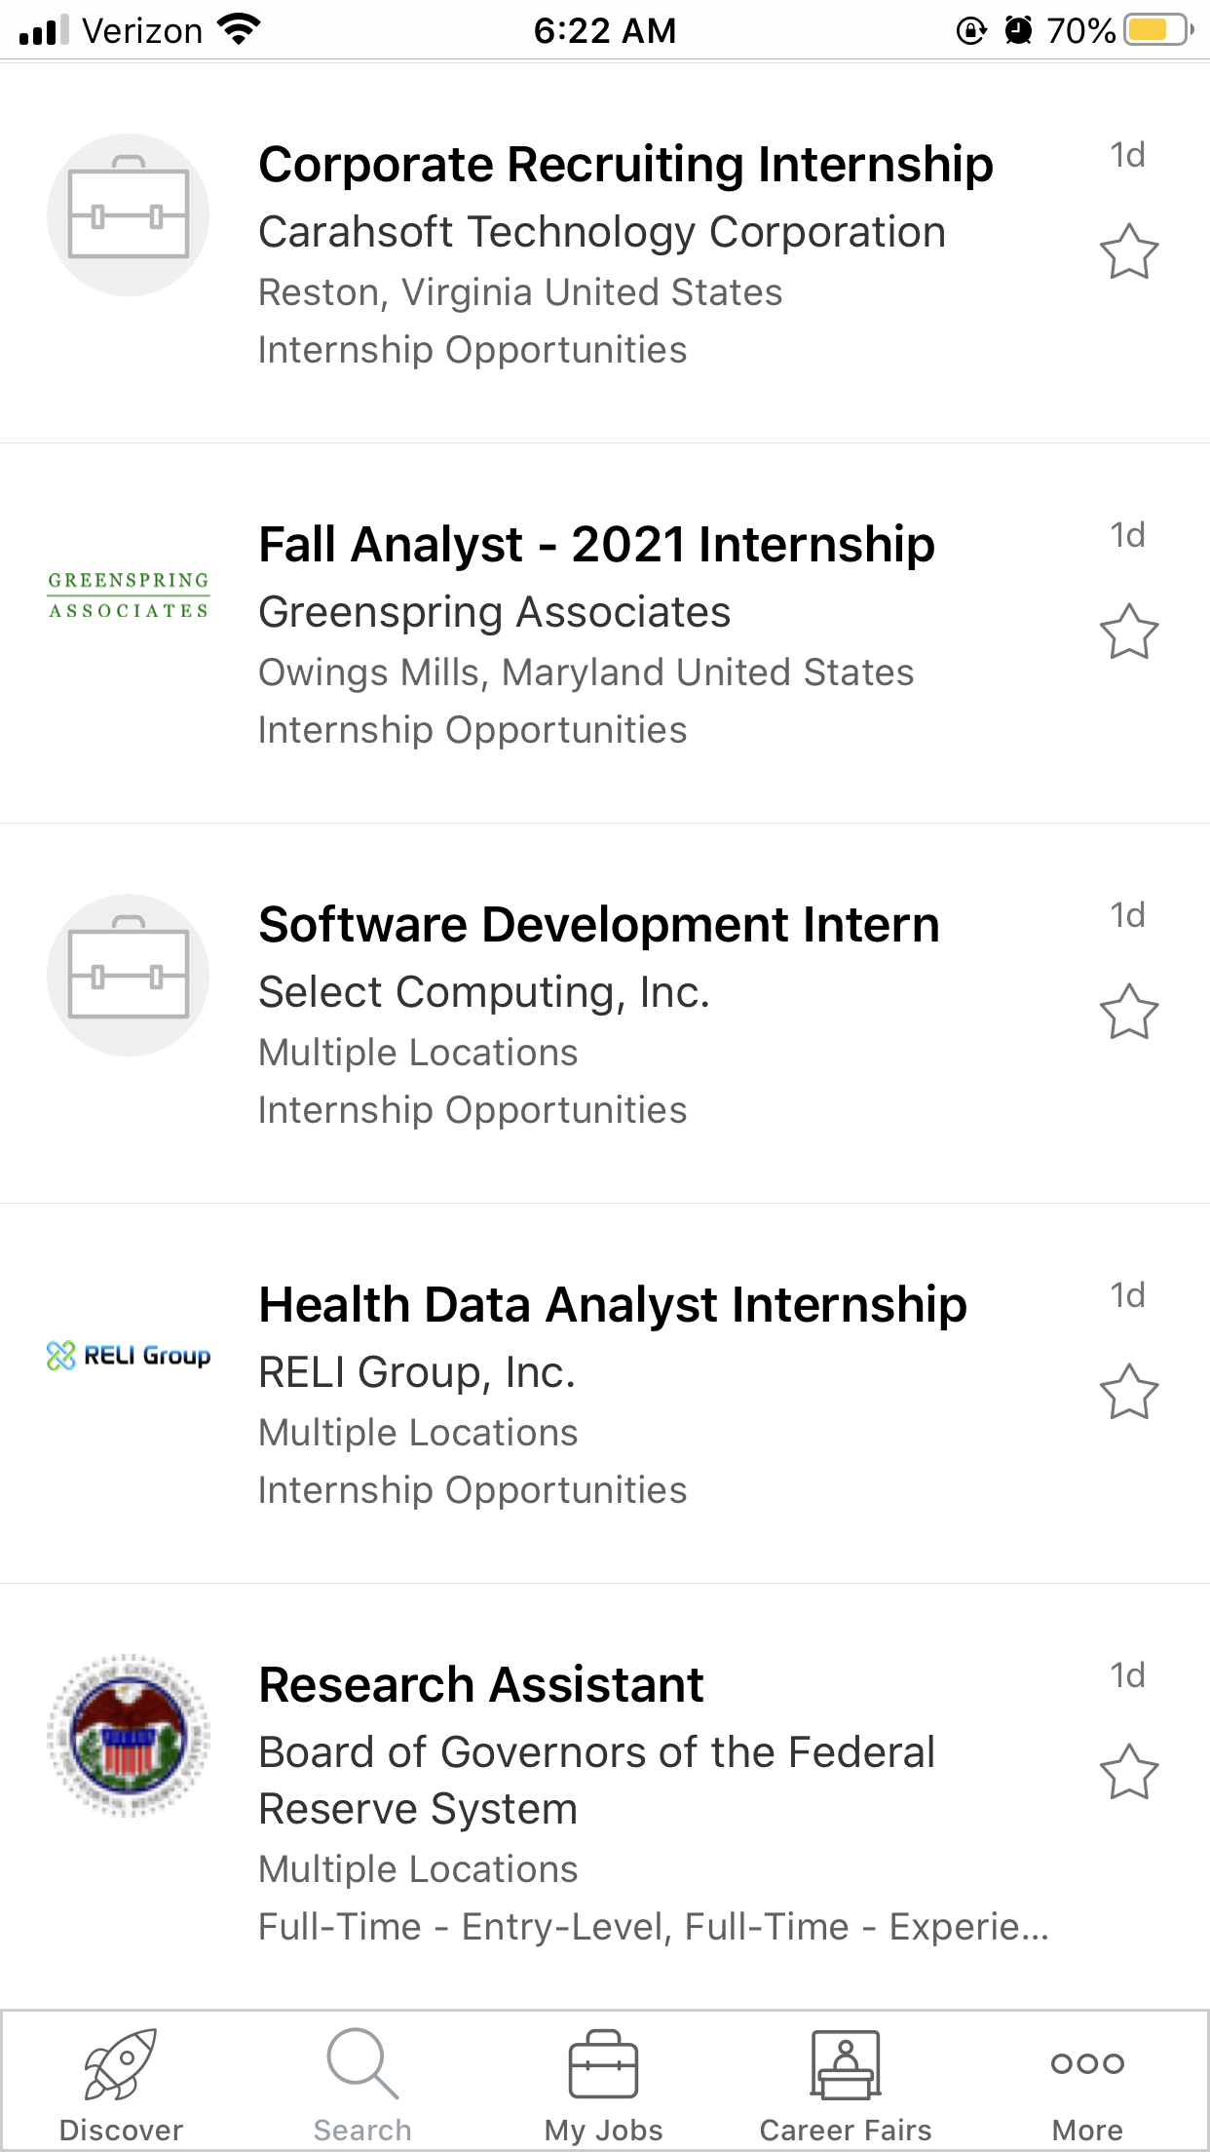
Gain experience now!
You can use the UMBCworks app on your phone to find jobs and internships on the go! These experiences can help you land that dream job in the future!
Most jobs are not published, so make sure you work on your networking skills to find out about new opportunities!
Place your screenshot here
Notes:
UMBCworks link: http://www.careers.umbc.edu/umbcworks/

Slide 10
UMBC Financial Smarts
A resource to help you get tips of how to better manage your money and plan for a good financial future
Relevant resources
CashCourse
CashCoach
CashClips
Notes:
UMBC Financial Smarts Website Link: https://financialsmarts.umbc.edu/

Slide 11
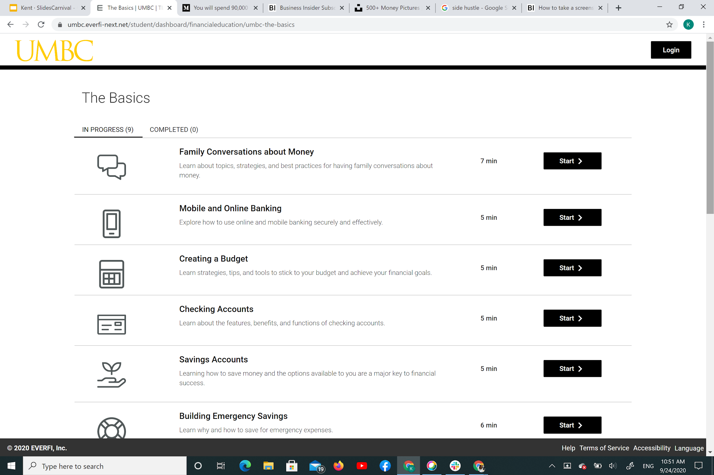
CashClips
Short modules that help students to gain financial literacy
Place your screenshot here

Slide 12
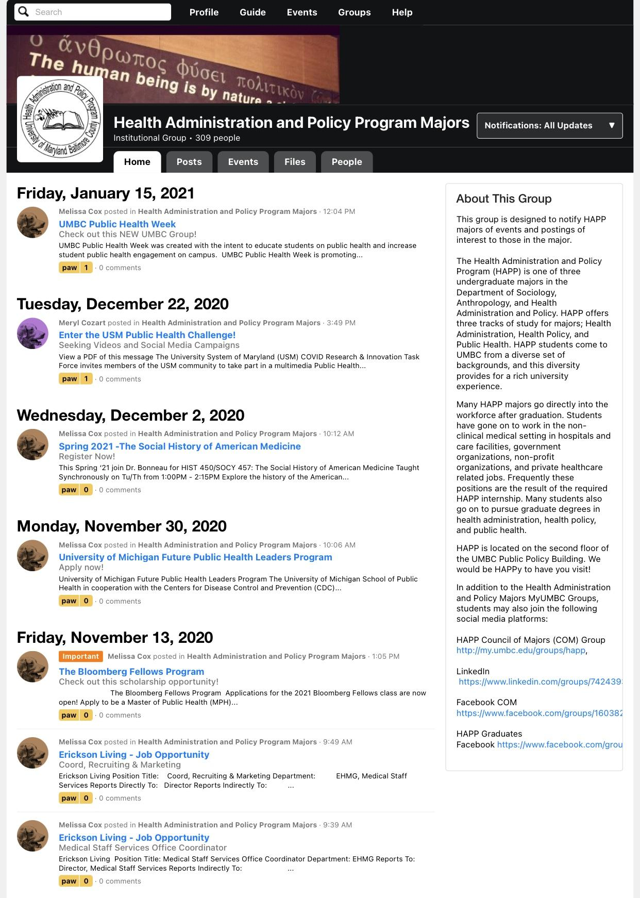
myUMBC
A great way to get involved with clubs and people within your major
Clubs can also provide networking opportunities as professors, alumni, or other professionals sometimes are guest speakers
myUMBC groups for your major can provide internship, job, and scholarship opportunities!
Notes:
myUMBC Academic Groups: Global Studies, Ancient Studies, Biology, Chemistry and Biochemistry, American Studies, and much more!
To find academic groups: Go to myUMBC, Click on “Groups”, and go to “Academic and Departamental”
Also get connected with outside organizations if you can

Slide 13
It is good to have more than one stream of income
Life can be unpredictable, and it’s important to be prepared. Explore side hustles or other options you can do to gain extra income.

Slide 14
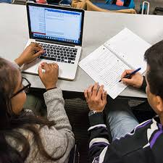
Academic Success Center
Academic Success Meetings can help you better manage your time, develop better study skills, and help you find resources on campus
If your situation is more dire, and Academic Advocate is a great way to get back on track and manage life struggles
Notes:
Academic Success Meeting link: https://lrc.umbc.edu/academic-success-meeting/
Academic Advocate link: https://academicadvocacy.umbc.edu/
Kayleigh

Slide 15
Professors
Professors are not only resources for learning, but opportunities to network and to help you outside of the classroom
Having great relationships for your teachers is important for research opportunities, recommendation letters, and more!
Notes:
Academic Success Meeting link: https://lrc.umbc.edu/academic-success-meeting/
Academic Advocate link: https://academicadvocacy.umbc.edu/

Slide 16
Thanks for Listening!
Any questions?
Make sure to follow OCSS on social media and myUMBC to stay up to date on all of our events!

Slide 17
Credits
Special thanks to all the people who made and released these awesome resources for free:
Presentation template by SlidesCarnival
Photographs by Unsplash

