Slide 1
NSF GRFP & Graduate School
SWE GBM: April 21st, 2021

Slide 2
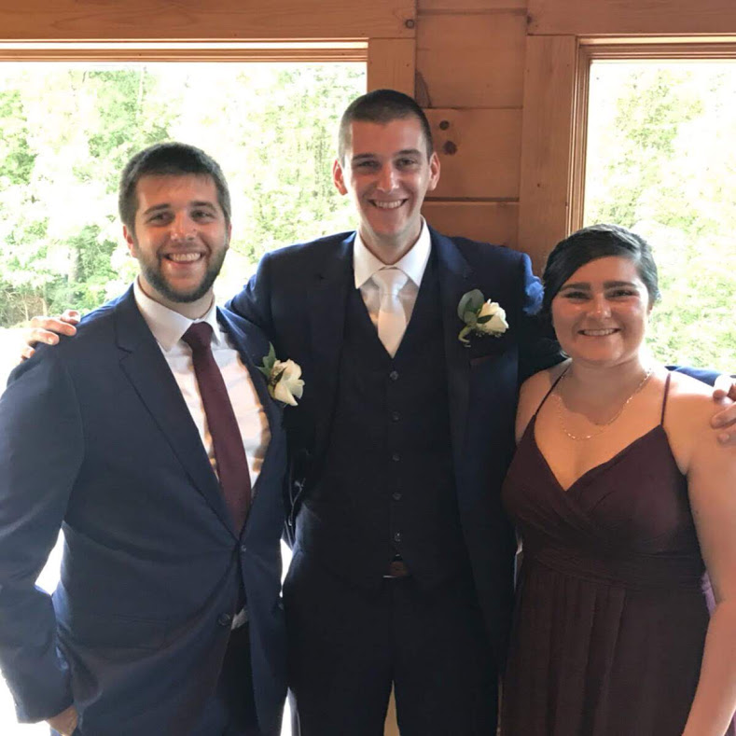
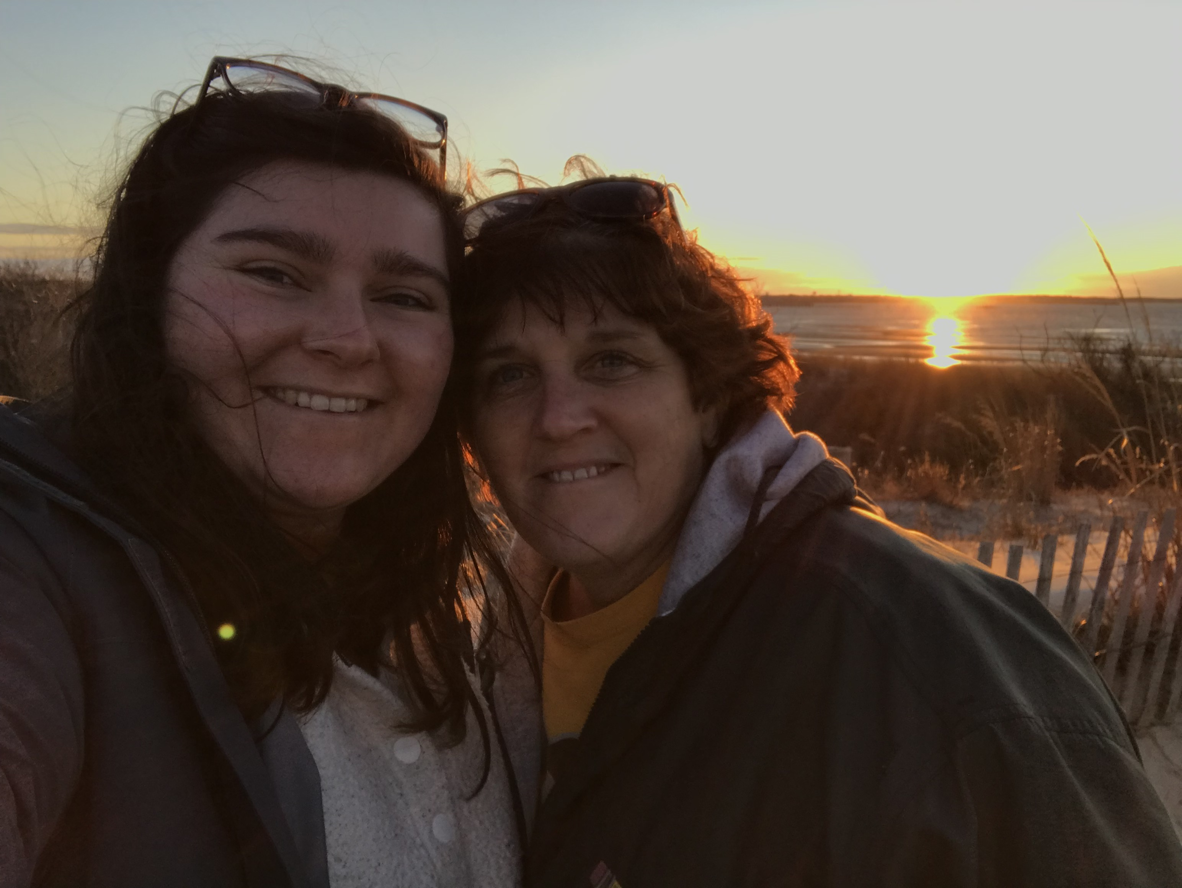
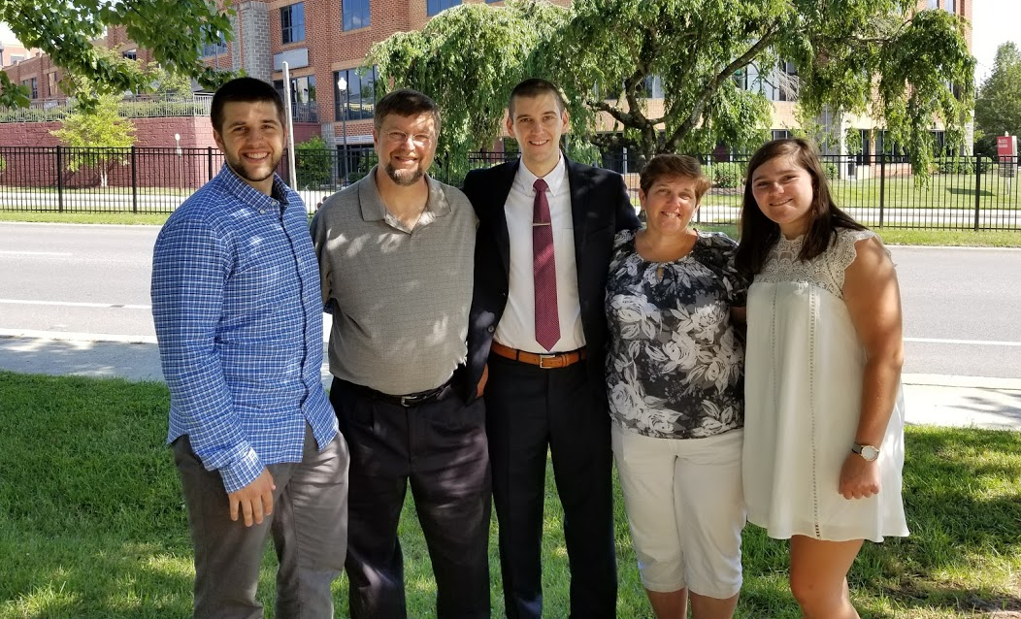
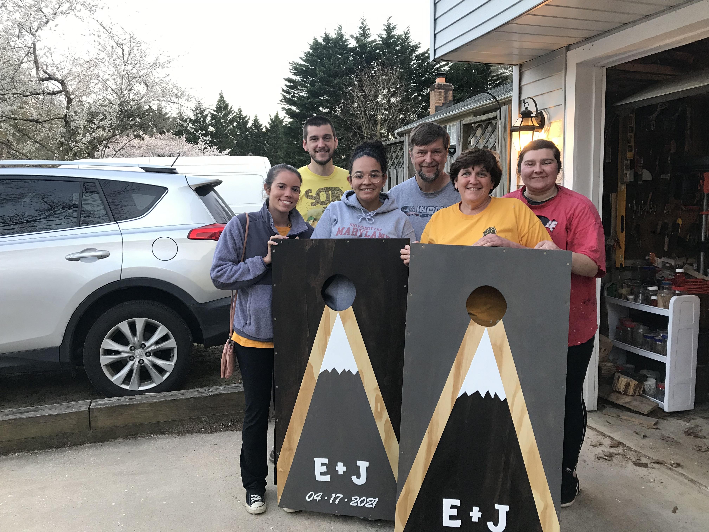
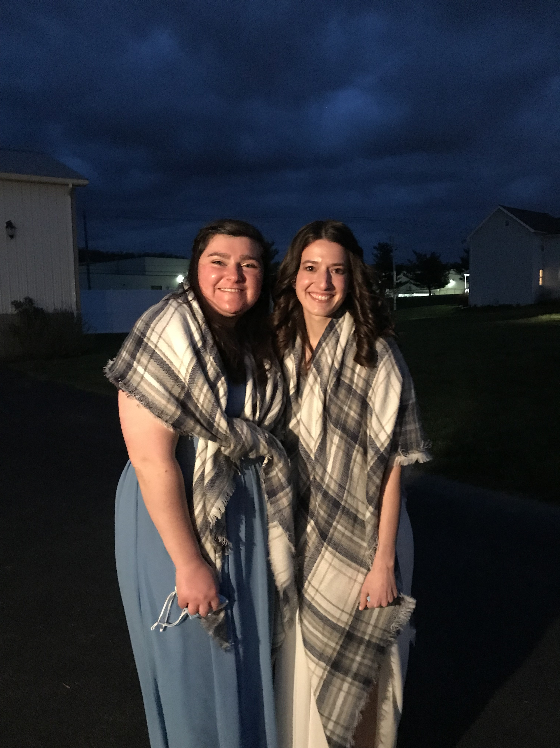
About me
Senior
Mechanical Engineering Major
Psychology Minor
C16 CWIT Scholar
Hometown: Pasadena, MD

Slide 3
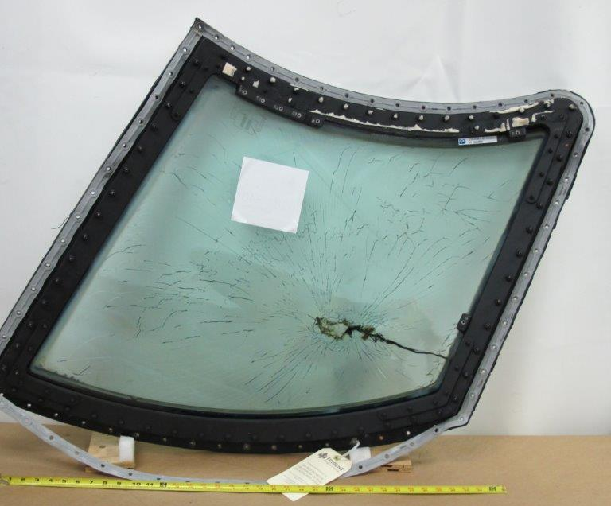
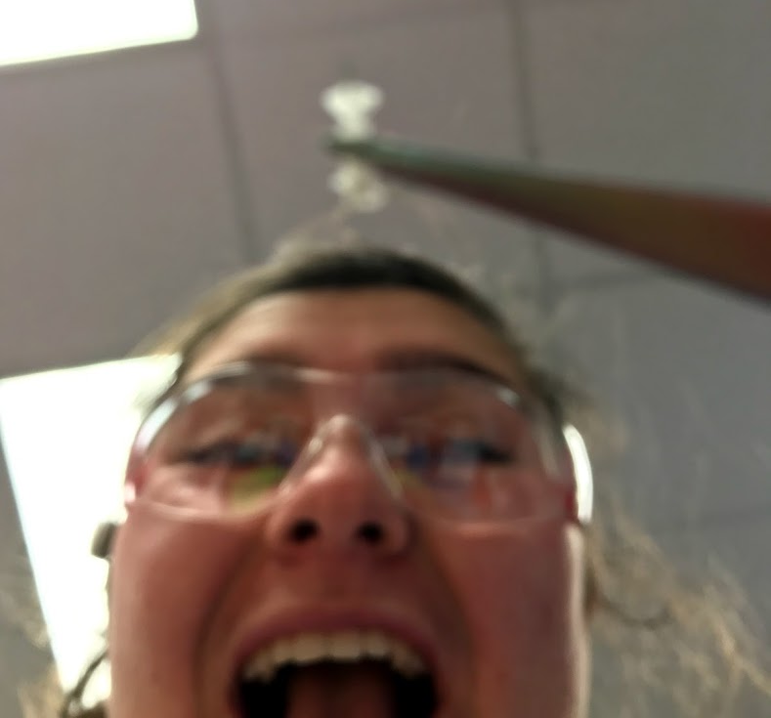
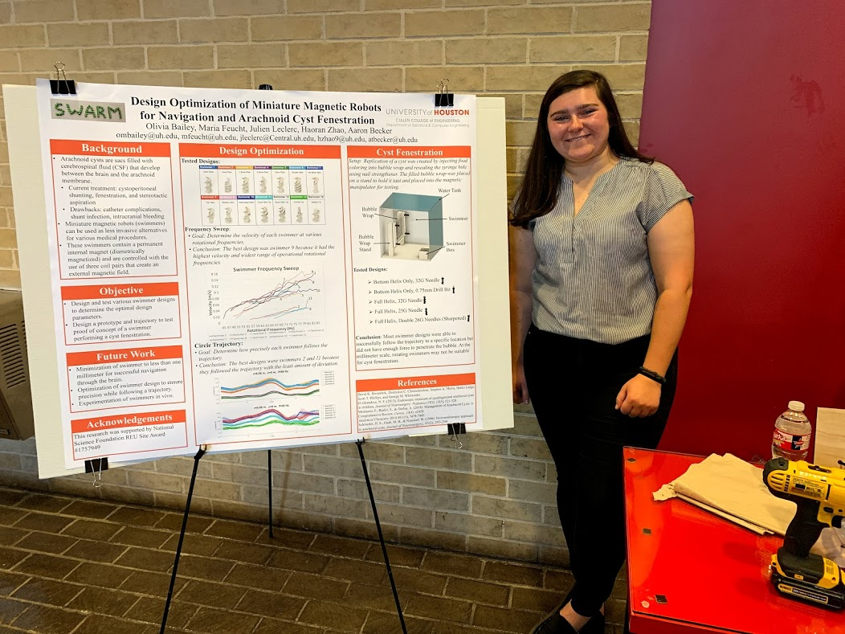
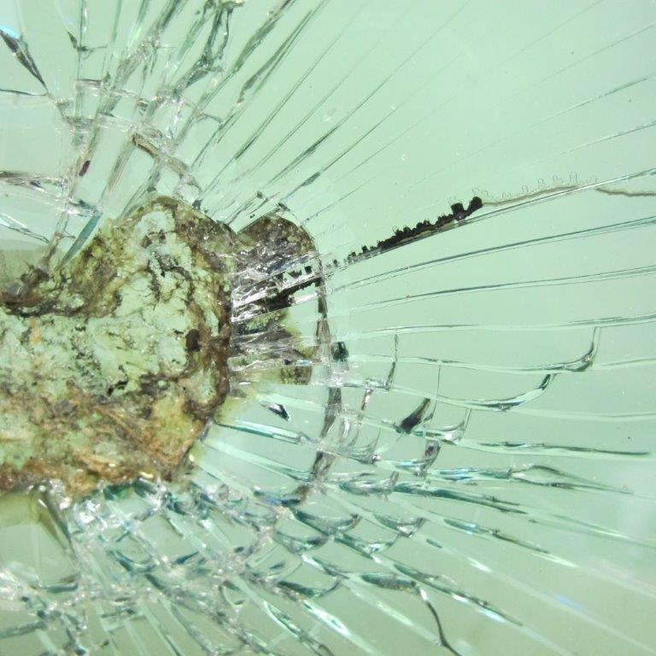
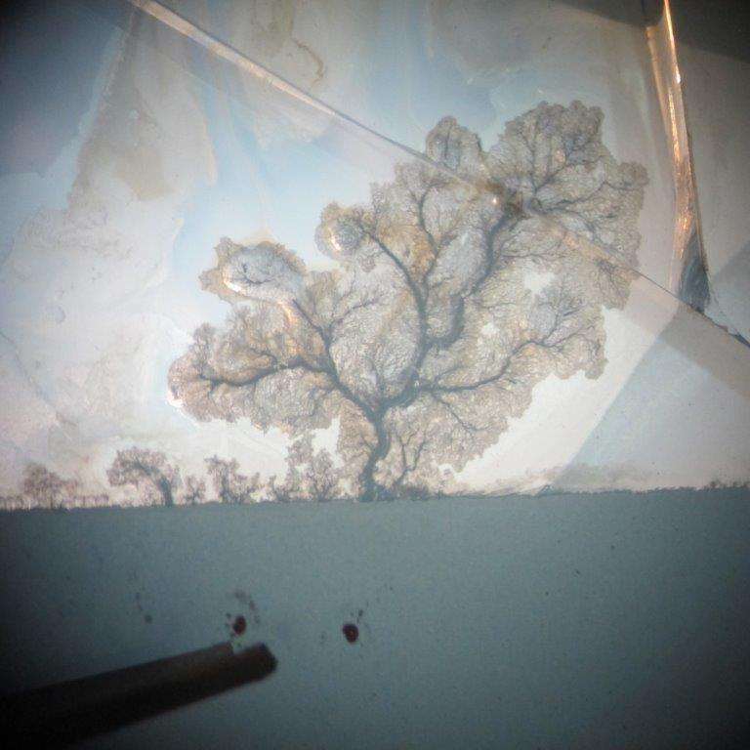
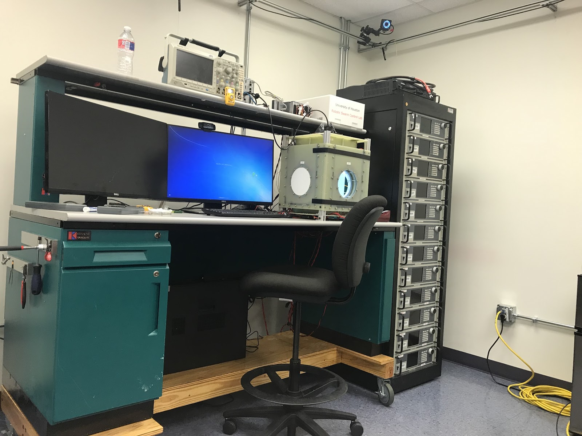
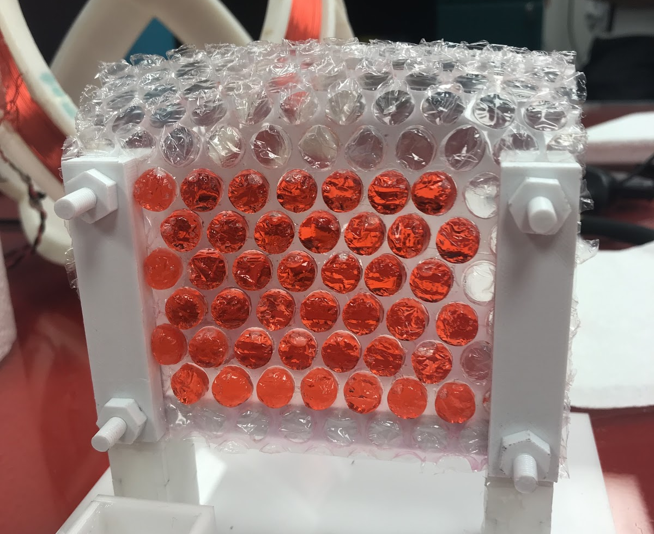
Experience

Slide 4
NFS GRFP

Slide 5
NSF GRFP – What is it?
National Science Foundation
Graduate Research Fellowship Program
Program for graduate students in NSF STEM supported disciplines who are pursing research-based master’s and doctoral degrees*
* from accredited US schools!
Prestigious and very competitive
Three years of financial support
Stipend amount of $34,000
Cost of education allowance of $12,000

Slide 6
GRFP Application Process
Application
3 Letters of Recommendation
List of your achievements/extracurriculars/etc.
Personal Essay
Very specific formatting requirements
Intellectual Merit
Broader Impacts
Career Goals/Professional Development Plans
Research Essay
Very specific formatting requirements
Original research topic
Intellectual Merit
Broader Impacts
Proposed Approach, Required Resources, etc.

Slide 7
Timeline
Application Due: October
Specific dates depend on which discipline you’re applying to
Final decisions sent out in early April

Slide 8
Graduate School

Slide 9
Graduate School Overview
Master’s Degree
“Second-cycle” academic degree
Allows for specialization/concentration on a specific aspect of a certain field
Good for qualifying for a leadership position
May be helping with changing careers or gaining new skills
Industry Jobs
PhD (Doctor of Philosophy)
“Terminal Degree”
Research based academic degree
Makes you an “expert” in the field on a certain subject/topic
Academia or Industry

Slide 10
Doctorate (PhD)
Master’s
Deepening research-based knowledge/skills
5 years (approximate)
Degree Requirements (in general)
Graduate Courses
Qualifying Exam/Presentation
Dissertation
Funding
Many programs offer fully funded programs (tuition & stipend)
Deepening career-oriented knowledge/skills
2 years (approximate)
Degree Requirements (in general)
Graduate Courses
Thesis
Funding
Grants/scholarships
Paid for by your employer

Slide 11
Academia
Teaching classes and conducting research
Flexibility
How and what you research
Research Timeline
Publications and Presentations
Collaboration/Competition
May be competitive between different schools and labs
Cross-disciplinary research (typically at your own school)
Requirements
Finding your own resources and funding
Career Advancement
Job security requires tenure

Slide 12
Industry
Wide variety of options for industry research
Typically, higher salary
Structure
Typically follows the standard 9-5
Follow direction from supervisors
Specific projects (less flexibility)
Quick timeline driven by business goals
Collaboration
Team oriented, Cross-disciplinary research
All working toward common goal!
Requirements
Funding and resources available
Career Advancement
Lots of room to advance and range in job type

Slide 13
How to Prepare while in Undergrad
Research Experience
REUs
On-campus research
Internships
TA/TF Experience
Leadership
Campus Involvement
Do well in classes

Slide 14
Why graduate school?

Slide 15
Timeline
Aug.–Sep.
GRE
Research Schools
Oct.–Nov.
Applications & Letters of Rec
Dec.–Jan.
Applications Due
Reach out to professors and grad students
Feb.–Mar.
Visit Weekends, Interviews, etc.
15 Apr.
Decision Day

Slide 16
Choosing Schools
To apply:
Location
General School Factors
Accreditation
Research
Topics, Professors, Departments
Final Decision
Where could you see yourself
Location!
PI
Research Project
Students
Support

Slide 17
Application Process
General Application
GRE (School dependent)
Letters of Recommendation
Typically between 2-3
Personal Essays
Why graduate school
Why that school specifically
What are your research interests
Extracurriculars/Achievements/etc.
Selecting Professors

Slide 18
Visit Weekends & Interviews

Slide 19
Questions?
obailey1@umbc.edu

